Slide 1


Slide 2

Matthew 22:37-40 ESV
“Teacher, which is the great commandment in the Law?” ³⁷ And he said to him, “You shall love the Lord your God with all your heart and with all your soul and with all your mind. ³⁸ This is the great and first commandment. ³⁹ And a second is like it: You shall love your neighbor as yourself.”

Slide 3


Slide 4
1. Effective evangelism is a process leading to an event.

Slide 5
Modified Engels Scale
-8 Awareness of a Supreme Being.
-7 Initial Awareness of the gospel; noticing that
there is something important about Jesus.
-6 Awareness of the fundamentals of the
Gospel: God, sin, Jesus, cross, faith.
-5 Grasp of the implications of the Gospel.
-4 Positive attitude toward the Gospel.
-3 Personal recognition of their sin problem
and need of the Gospel.
-2 Decision to act.
-1 Repentance and faith in Jesus.

Slide 6
2. Effective evangelism is the result of winning three relational battles.

Slide 7
Proverbs 11:30 KJV
The fruit of the righteous is a tree of life, and whoever captures [wins] souls is wise.

Slide 8
Win them to you.

Slide 9
Win them to you.
Win them to your group of Christian friends, your church,
or your small group.

Slide 10
Win them to you.
Win them to your group of Christian friends, your church,
or your small group.
Win them to Christ.

Slide 11
3. Effective evangelism only asks for the level of commitment the other person is ready to give.

Slide 12
4. Effective evangelism is something we do not do alone.
Acts 1:8; Matthew 28:19-20

Slide 13
Acts 1:8
“But you will receive power when the Holy Spirit has come upon you, and you will be my witnesses in Jerusalem and in all Judea and Samaria, and to the end of the earth”
Matthew 28:19-20
“Go therefore and make disciples of all nations, baptizing them in the name of the Father and of the Son and of the Holy Spirit, ²⁰ teaching them to observe all that I have commanded you. And behold, I am with you always, to the end of the age.”

Slide 14
Romans 8:11
the Spirit of Him who raised Jesus from the dead dwells in you
2 Timothy 2:7
for God gave us a spirit not of fear but of power and love and self-control.

Slide 15
5. You Can’t Mess This Up.

Slide 16
Three Practices:
1. PRAY FOR YOUR FRIEND
Ask God to bless them
Ask God to be at work in their lives
Ask God to give you opportunities to care for and share with them

Slide 17
Three Practices:
2. CARE FOR YOUR FRIEND
Listen to your neighbor
Eat with your neighbor
Serve your neighbor

Slide 18
Three Practices:
3. SHARE WITH YOUR FRIEND
A word about God
A mini testimony of one or two sentences
An invite to church
A recovery testimony
Your testimony
God’s story

Slide 19
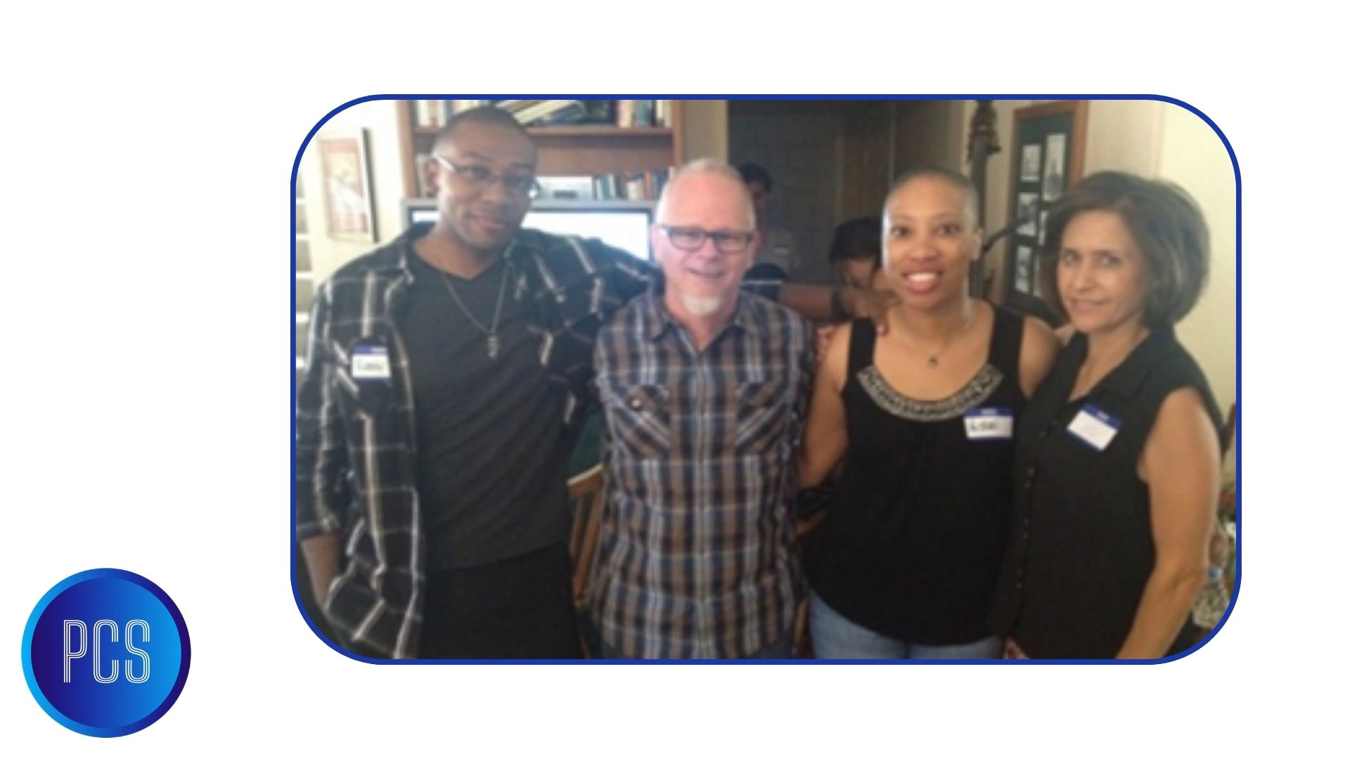

Slide 20
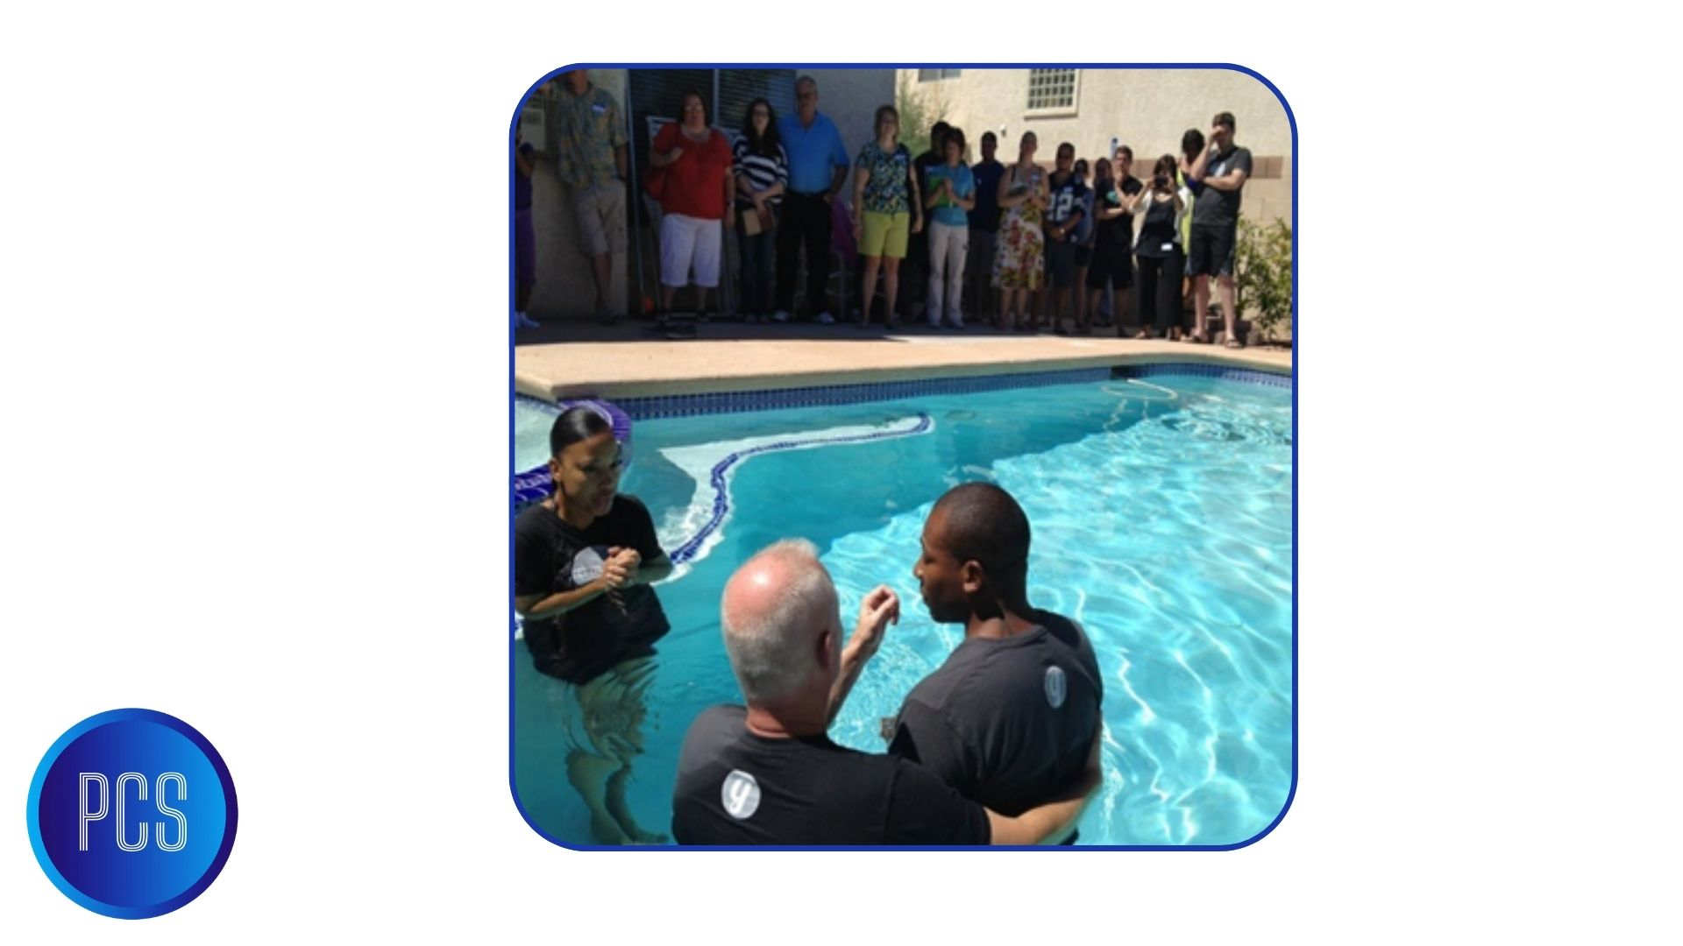

Slide 21
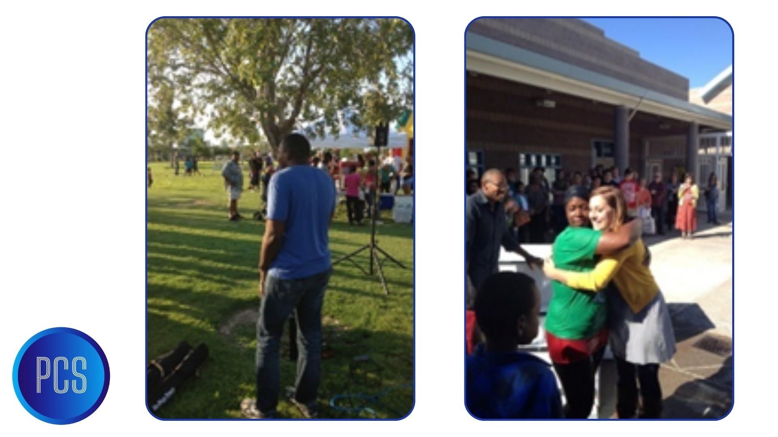

Slide 22
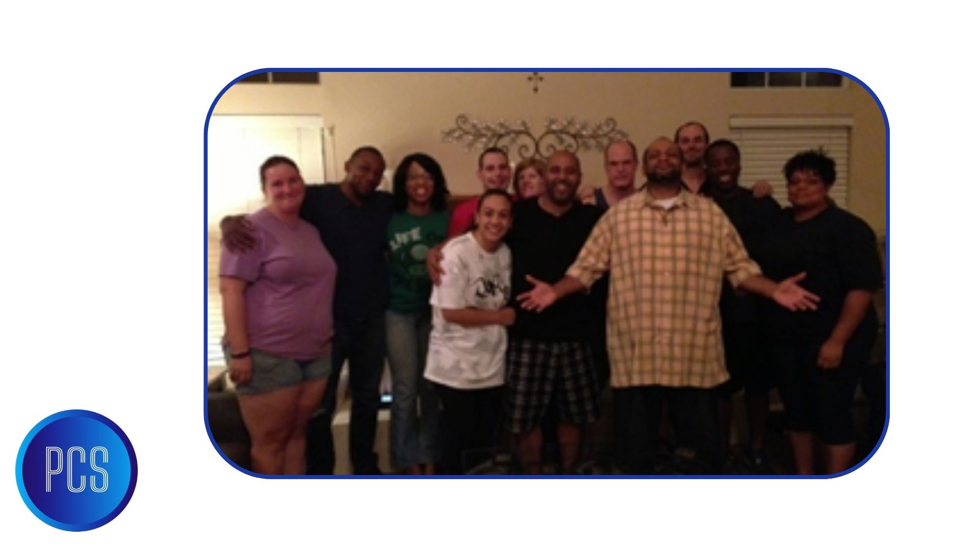

Slide 23
