Slide 1
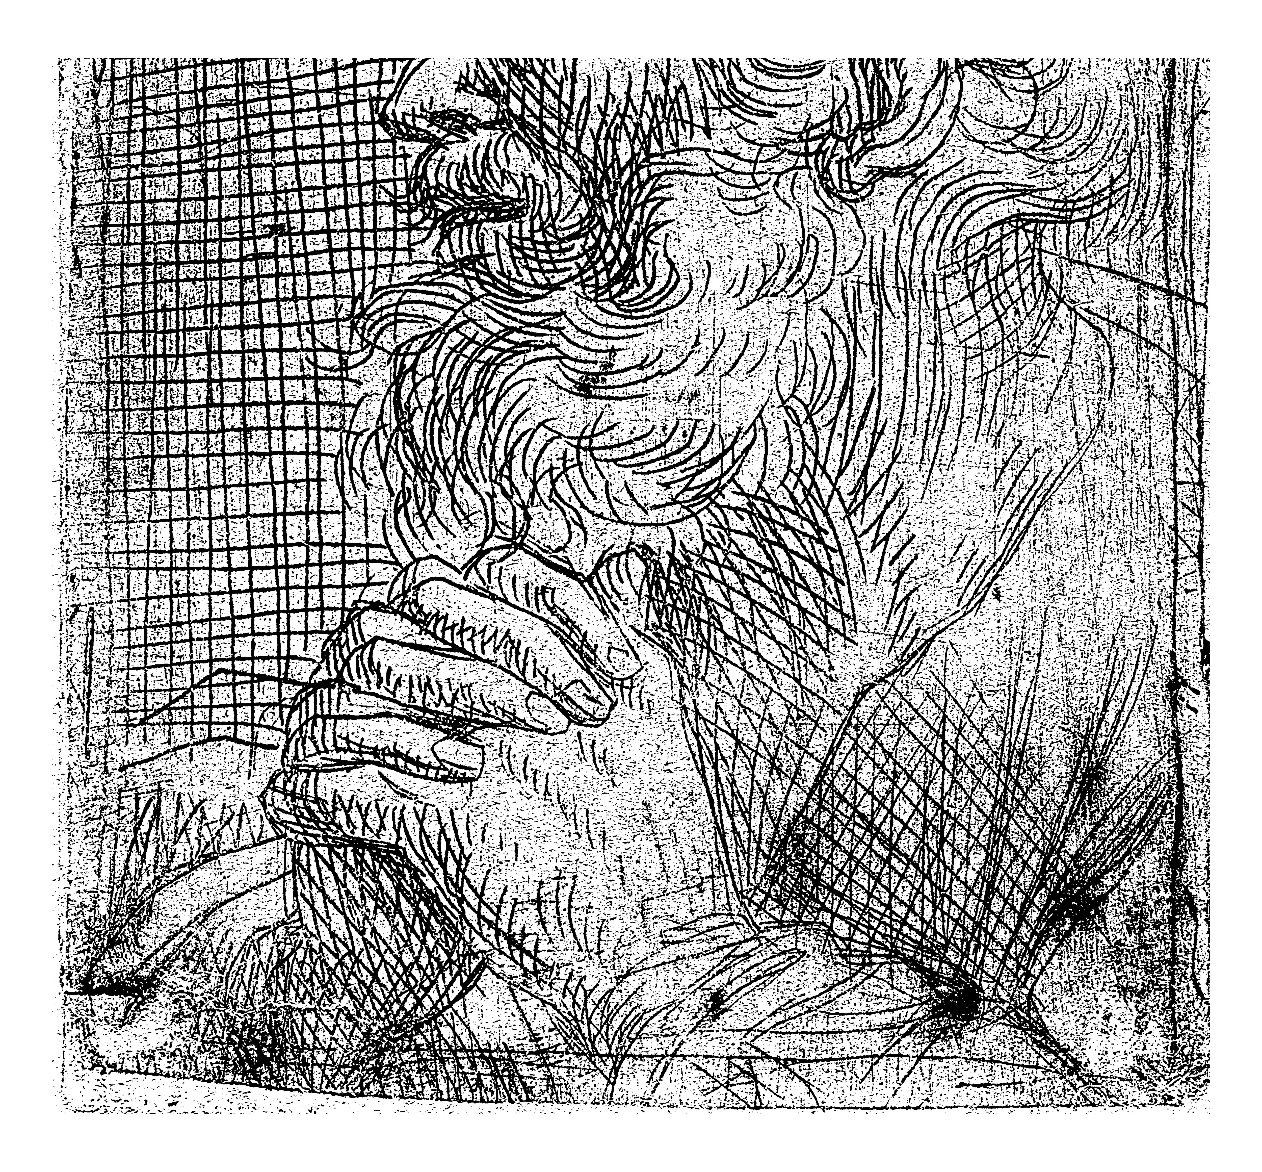
God’s Work God’s Way
Genesis 16
William “Duce” Branch

Slide 2
"There are two kinds of people: those who say to God, 'Thy will be done,' and those to whom God says, 'All right, then, have it your way.'"
-C.S. Lewis-

Slide 3
The Context of Our Gifts and Calling:
The Initiation of God
(Gen 12-17)
Gen 12:1-3 - ¹ The Lord said to Abram: Go from your land, your relatives, and your father’s house to the land that I will show you. ² I will make you into a great nation, I will bless you, I will make your name great, and you will be a blessing. ³ I will bless those who bless you, I will curse anyone who treats you with contempt, and all the peoples on earth will be blessed through you.

Slide 4
The Context of Our Gifts and Calling:
The Initiation of God
(Gen 12-17)
Gen 13:14-17 - ¹⁴ After Lot had separated from him, the Lord said to Abram, “Look from the place where you are. Look north and south, east and west, ¹⁵ for I will give you and your offspring forever all the land that you see. ¹⁶ I will make your offspring like the dust of the earth, so that if anyone could count the dust of the earth, then your offspring could be counted. ¹⁷ Get up and walk around the land, through its length and width, for I will give it to you.”

Slide 5
The Context of Our Gifts and Calling:
The Initiation of God
(Gen 12-17)
Gen 15:1 - After these events, the word of the Lord came to Abram in a vision: Do not be afraid, Abram. I am your shield; your reward will be very great.

Slide 6
The Context of Our Gifts and Calling:
The Initiation of God
(Gen 12-17)
Gen 17:1-5 - When Abram was ninety-nine years old, the Lord appeared to him, saying, “I am God Almighty. Live in my presence and be blameless. ² I will set up my covenant between me and you, and I will multiply you greatly.” ³ Then Abram fell facedown and God spoke with him: . . . ⁵ Your name will no longer be Abram; your name will be Abraham, for I will make you the father of many nations.

Slide 7
If a commission by an earthly king is considered an honor, how can a commission by a Heavenly King be considered a sacrifice?
-David Livingstone-

Slide 8
A Key Conflict in Our Life and Ministry:
The Means and Method of God
(Gen 16:1-6)
Gen 16:1-3 - ¹ Abram’s wife, Sarai, had not borne any children for him, but she owned an Egyptian slave named Hagar. ² Sarai said to Abram, “Since the Lord has prevented me from bearing children, go to my slave; perhaps through her I can build a family.” And Abram agreed to what Sarai said. ³ So Abram’s wife, Sarai, took Hagar, her Egyptian slave, and gave her to her husband, Abram, as a wife for him. This happened after Abram had lived in the land of Canaan ten years.

Slide 9
A Key Conflict in Our Life and Ministry:
The Means and Method of God
(Gen 16:1-6)
Gen 16:4-6 - ⁴ He slept with Hagar, and she became pregnant. When she saw that she was pregnant, her mistress became contemptible to her. ⁵ Then Sarai said to Abram, “You are responsible for my suffering! I put my slave in your arms, and when she saw that she was pregnant, I became contemptible to her. May the Lord judge between me and you.” ⁶ Abram replied to Sarai, “Here, your slave is in your power; do whatever you want with her.” Then Sarai mistreated her so much that she ran away from her.

Slide 10
You can expect conflict when we try to do
God’s will man’s way.

Slide 11
The Great Comfort
We Have:
The Grace and Mercy of God
(Gen 16:7-13)
Gen 16:7-8 - ⁷ The angel of the Lord found her by a spring in the wilderness, the spring on the way to Shur. ⁸ He said, “Hagar, slave of Sarai, where have you come from and where are you going?” She replied, “I’m running away from my mistress Sarai.”

Slide 12
The Great Comfort
We Have:
The Grace and Mercy of God
(Gen 16:7-13)
Gen 16:9-12 - ⁹ The angel of the Lord said to her, “Go back to your mistress and submit to her authority.” ¹⁰ The angel of the Lord said to her, “I will greatly multiply your offspring, and they will be too many to count.” ¹¹ The angel of the Lord said to her, “You have conceived and will have a son. You will name him Ishmael, for the Lord has heard your cry of affliction. ¹² This man will be like a wild donkey. His hand will be against everyone, and everyone’s hand will be against him; he will settle near all his relatives.”

Slide 13
The Confidence Gained from His Consistent Character
(Gen 16:13-16)
Gen 16:13-16 - ¹³ So she named the Lord who spoke to her: “You are El-roi,” for she said, “In this place, have I actually seen the one who sees me? ” ¹⁴ That is why the well is called Beer-lahai-roi. It is between Kadesh and Bered. ¹⁵ So Hagar gave birth to Abram’s son, and Abram named his son (whom Hagar bore) Ishmael. ¹⁶ Abram was eighty-six years old when Hagar bore Ishmael to him.

Slide 14
"Faith is not resignation to a power we do not know; faith is committal to One Whose character we do know because it has been revealed to us in Jesus Christ."
-Oswald Chambers-

Slide 15
Conclusion/Applications:
Trust God’s heart to help you receive whatever comes from his hand.

Slide 16
Conclusion/Applications:
Trust God’s heart to help you receive whatever comes from his hand.
Trust God’s turnings and his timing.

Slide 17
“I'll go anywhere as long as it's forward.”
“Without Christ, not one step; with Him, anywhere!”
-David Livingstone-

Slide 18
Conclusion/Applications:
Trust God’s heart to help you receive whatever comes from his hand.
Trust God’s turnings and his timing.
Trust God for eternal salvation and earthly sustenance.

Slide 19
Conclusion/Applications:
Trust God’s heart to help you receive whatever comes from his hand.
Trust God’s turnings and his timing.
Trust God for eternal salvation and earthly sustenance.
Trust God’s way for your ministry methods and ministry outcomes.

Slide 20
“God's work done in God's way will never lack God's supply.”
-Hudson Taylor-

Slide 21
"God always gives His best to those who leave the choice with Him."
-Jim Elliott-

