Slide 1
Reaching the Next Generation

Slide 2
Question Areas
Relationships
Lifestyle
Purpose
Belonging
Beliefs

Slide 3
Relationships
What is love? What does love look like? What doesn’t love look like?
Who is going to love me?
How do I treat my family? My friends? My neighbor? Someone I don’t really know? My enemy?
How should I expect people to treat me?
Should I forgive them? When should I ask for forgiveness?

Slide 4
Lifestyle
What is the “Good Life?”
What kind of life will make me happy? Bring me peace? Bring me joy?
Can I change? Can I get better? Can I become a different person?
How do I avoid the mistakes of my parents?
What do I do with regrets? With guilt? With shame? With worry?

Slide 5
Purpose
How should I spend my time?
What is worth my effort and energy?
What should I value?
How do I live a balanced life?
How do I deal with failure? With success?

Slide 6
Belonging
Who are my people?
Where do I fit in? Should I try to fit in? Should I change to fit in?
What do I need to feel at home? Can I make others feel at home? Should I try?
How do I balance finding the right place with creating the right place?
What if I lose my place or my people?

Slide 7
Beliefs
What is true? Is there truth? Can I find it?
Who do I trust? Who is going to tell me the truth?
How do I know if something is true?
How certain do I need to be in order to trust something?
How does the truth affect my life?

Slide 8
Jesus’ life, death, and resurrection directly impacts each of these five areas.
The Gospel

Slide 9
The Gospel and Question Areas
Our restored relationship with God through the forgiveness of our sins because of Jesus’ life, death, and resurrection should change
our relationships,
our lifestyle,
our purpose,
our sense of belonging,
and our beliefs.

Slide 10
Telling Stories
We should have life stories about how the Gospel has changed
How we relate to others
How we live our lives
What we see as our purpose
Where we feel like we belong
Who we trust

Slide 11

Knock, Knock. Who’s There?
Knowing Your Neighbor in Light of the Gospel.
By Rev. Brian J Musser
INSERT QR CODE FOR THIS RESOURCE
https://peaceandpoweratdrexel.wordpress.com/wp-content/uploads/2022/05/lovepasj-bible-study-5.5x8.5.pdf

Slide 12
Other Resources

Slide 13
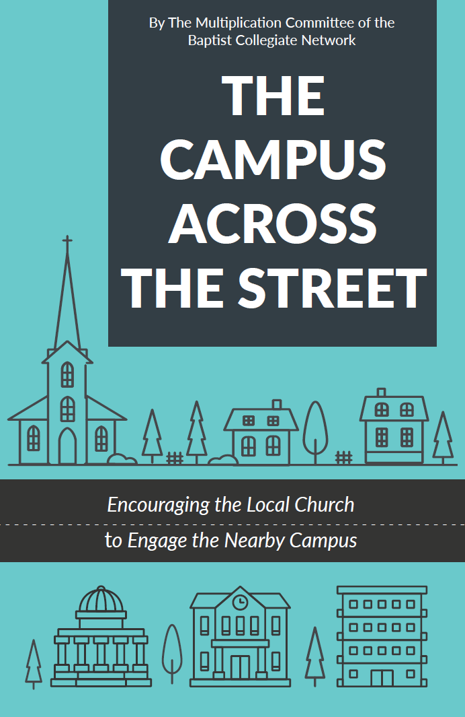
The Campus Across the Street:
Encouraging the Local Church to Engage the Nearby Campus.
By the Multiplication committee of the Baptist Collegiate Network
Crossing the Street
Go to Them
Go Together
Go in Prayer
Go with Love
Go and Connect
Go and Share
Go and Proclaim
INSERT QR CODE FOR THIS RESOURCE
https://peaceandpoweratdrexel.wordpress.com/wp-content/uploads/2024/06/the-campus-across-the-street-june-2024.pdf

Slide 14

INSERT QR CODE FOR THIS RESOURCE
https://www.brnunited.org/cm/
www.brnunited.org/cm/
YouTube Playlists:
Evangelism
Professional Development
Thinking About the Next Generation
AMPLIFY – Fall Young Adult Retreat
Campus Missionary Learning Communities

Slide 15
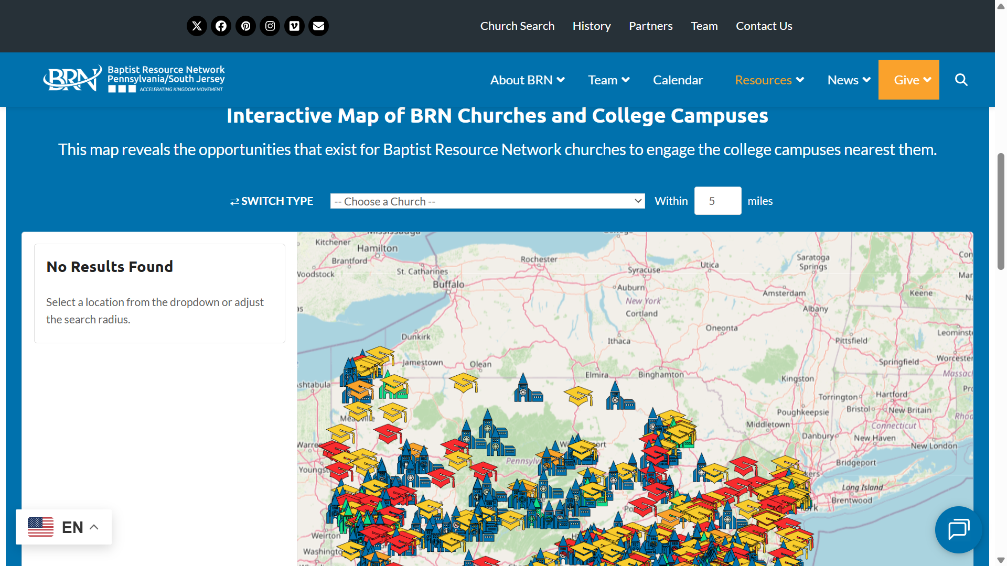

Slide 16
Links
EveryCampus
CRU – Soularium
Cross Organizational Evangelism Workshop
VIA – EDM ‘25
NAMB – GenSend
IMB Students
Every Student Sent
Baptist Collegiate Network
Campus Multiplication Network
InterVarsity – 5 Thresholds

