Slide 1
Bold Missions
Local and foreign
are both and
not either or

Slide 2
Ricky wilson
Pastor of Christian Faith Fellowship
Executive Board Member of BRN
IMB Trustee Member
President of Africa Partnership
Website africapartnership.us
Facebook Africa Partnership

Slide 3
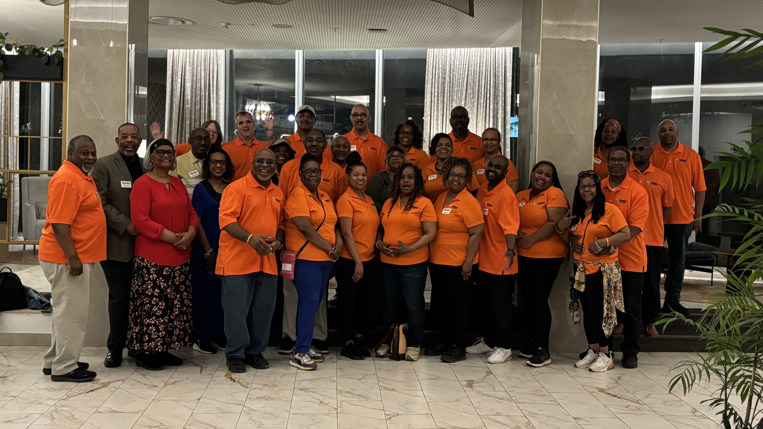
A/P Team 2025

Slide 4
Scripture for our engaged collaboration
Our Collaboration is fueled by Prayer (Hebrews 4:16)
Our Collaboration is divinely Planned (Acts 1:8)
Our Collaboration requires a yes from People (Isa. 6:8)
Our Collaboration involves team Commitment (Amos 3:3)

Slide 5
The 4 c’s of mission
Community
Country
Continent
Cosmos

Slide 6
Bold collaboration
Agree on the Purpose
Agree on the Plan
Agree on the People
Agree on the Place
Agree on the Project
Agree on the Profit

