Slide 1
EVANGELISM FOR KIDS
GUIDING CHILDREN TO UNDERSTAND AND RESPOND TO THE GOSPEL
Notes:
what we'll cover:
the importance of including evangelism to kids in our ministries.
Presenting the gospel with kids in mind.
what happens after a kid says yes to Jesus?

Slide 2
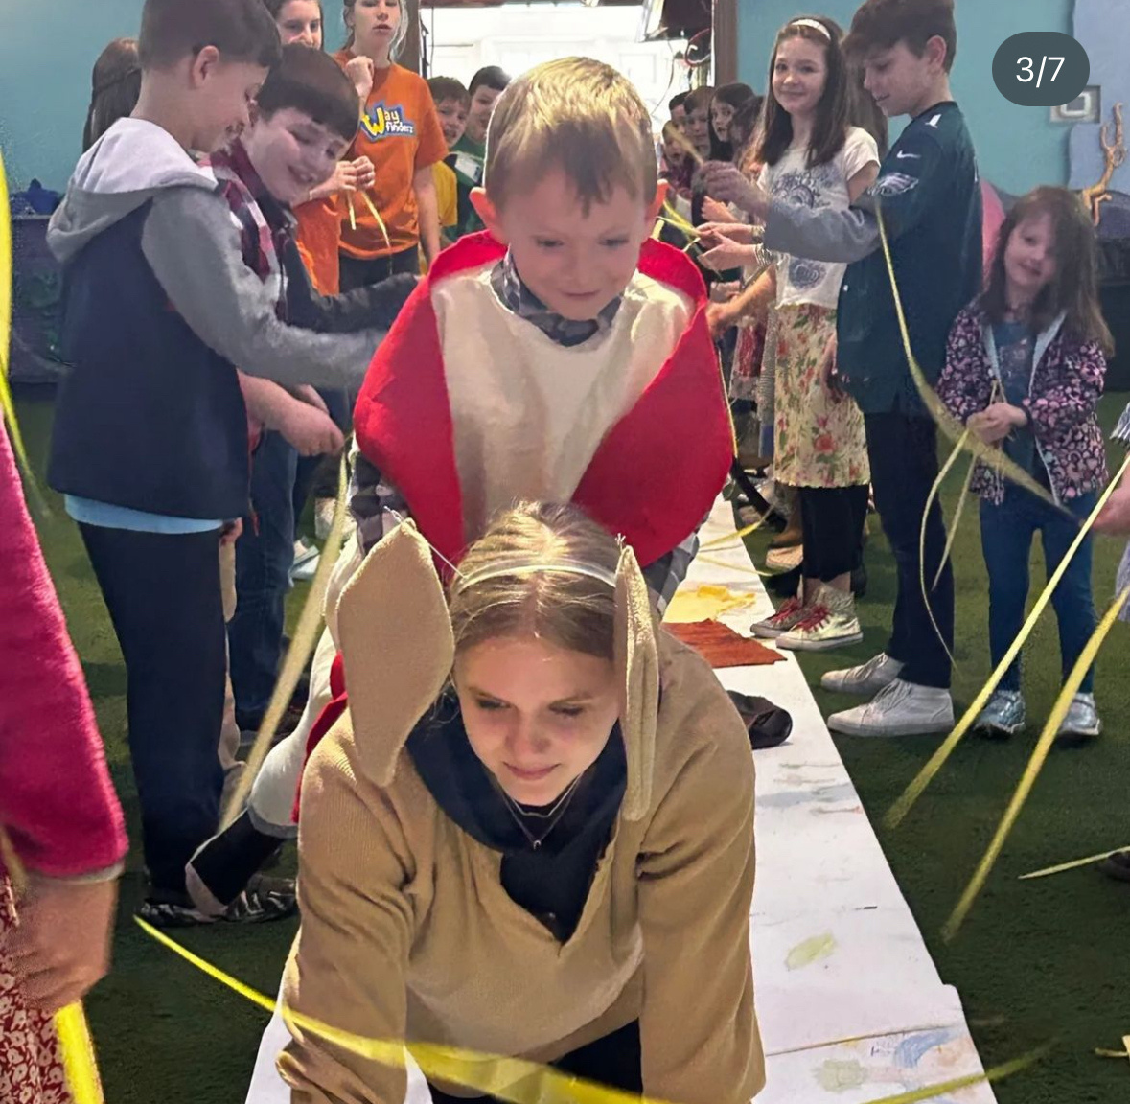
THINK ABOUT THE FIRST TIME YOU UNDERSTOOD
THE GOSPEL
WHO HELPED YOU UNDERSTAND IT CLEARLY?
Notes:
Ice Breaker.

Slide 3

IF kids have trusted Jesus as their Savior
“KIDS ARE NOT THE FUTURE OF THE CHURCH.
THEY ARE THE CHURCH RIGHT NOW.”
Notes:
The distinction matters.
It frames how we do ministry.
Often in kids ministries we are either trying to be evangelistic or we are trying to disciple young believers.
However, today, I want us to explore how maintaining a focus of evangelism to kids actually leads to discipleship.

Slide 4
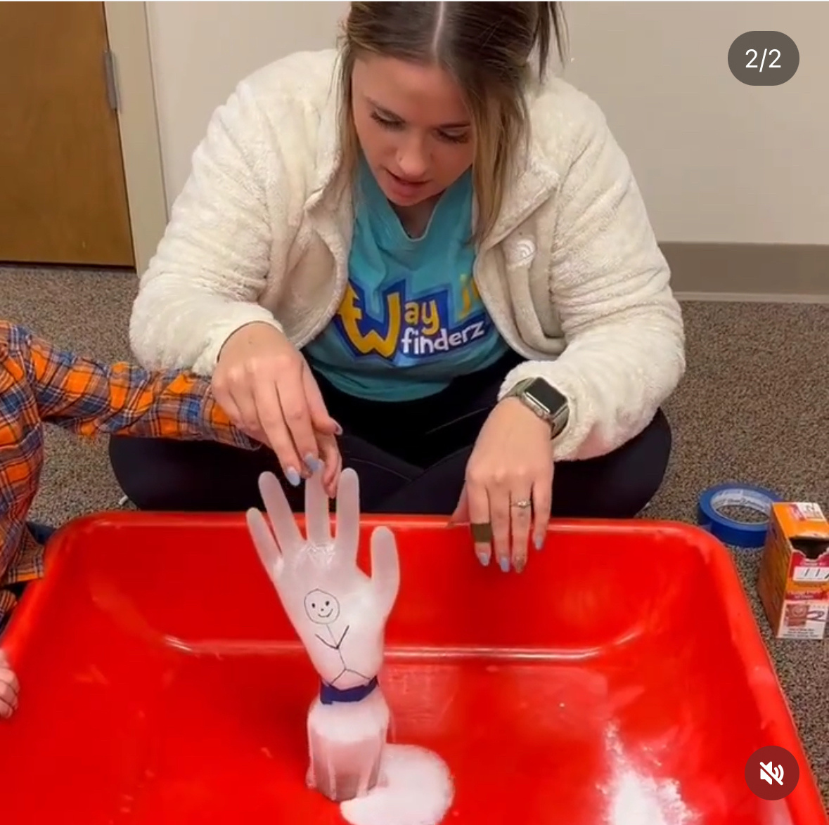
OUR RESPONSIBILITY IS NOT JUST TO CARE FOR KIDS AND SHARE THE GOSPEL ONE TIME
IT’S TO FAITHFULLY INTRODUCE THEM TO JESUS OVER AND OVER
Notes:
Most kids do not decide to surrender their lives to Jesus after hearing the gospel one time. Those who do sometimes grow and decide that they didn't really understand what they were doing and make a profession of faith later in life. - This is why it is so important that our kid's ministries remain evangelistic - gospel centered.
What does this look like?
Weekly gospel presentations with a clear opportunity to respond.
Outreach events that provide a gospel message in language that kids can understand.
We leave room for the Holy Spirit to work miraculously because we know He can.
We work faithfully because we believe God's Word:
Paul shared:
1 Corinthians 3:6–7 (CSB)
“I planted, Apollos watered, but God gave the growth.
So then neither the one who plants nor the one who waters is anything, but only God
Galatians 6:9
9 Let us not get tired of doing good, for we will reap at the proper time if we don’t give up.
We plant. We water. God brings the growth. So, we don't grow weary in this good work because we trust God to be God. And that is very important when we think about evangelism to kids.
Evangelism to kids is a long game.

Slide 5
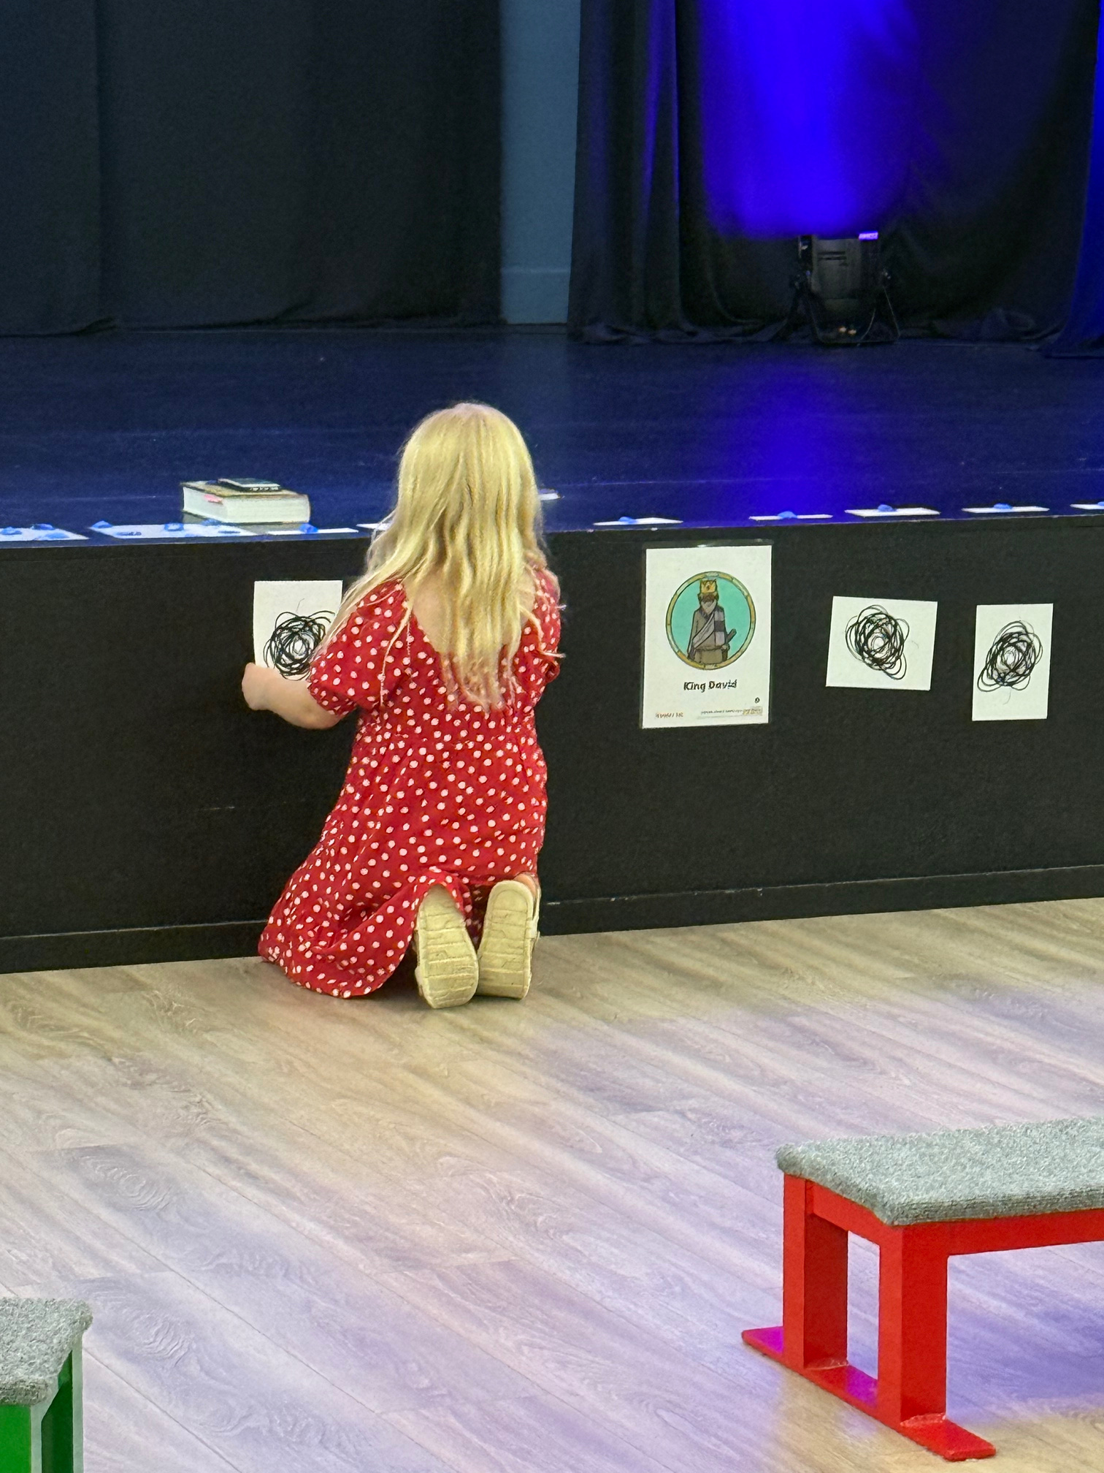
This is our job
THE GOSPEL
MUST BE CLEARLY SHARED AND PERSONALLY RECEIVED
This is the work of the Holy Spirit
Notes:
There are things that only the Holy Spirit can do.
And yet, there are things that we MUST take responsibility for if we want to lead kids to Jesus.
We must share the gospel clearly.
Methods can change - and should. (different learning types, different generations, etc)
But what never changes? Someone must share the good news - with kids in a way that they can understand.

Slide 6
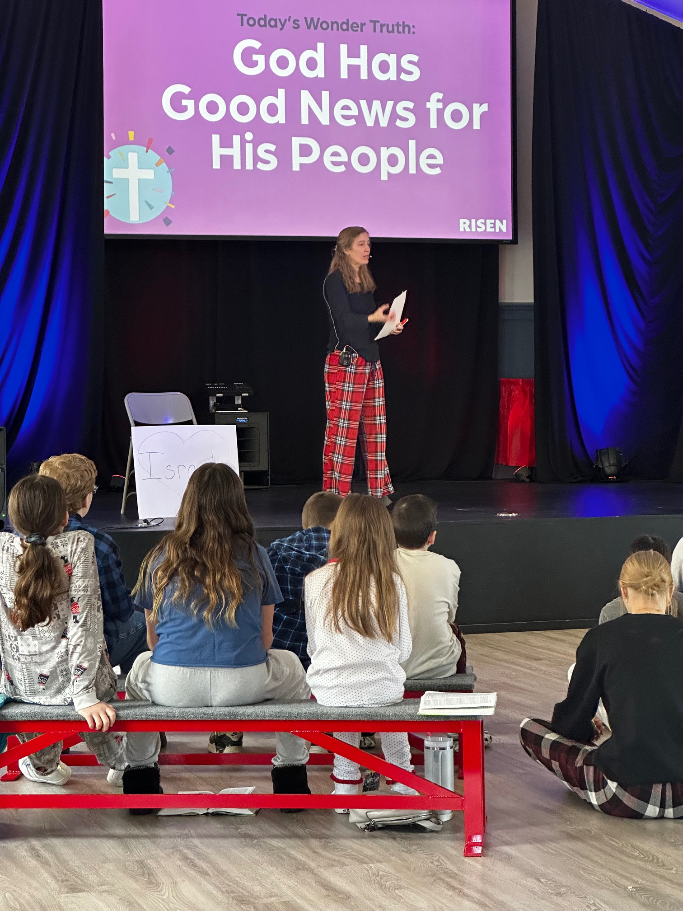
HOW THEN SHALL THEY CALL ON HIM IN WHOM THEY HAVE NOT BELIEVED? AND HOW SHALL THEY BELIEVE IN HIM OF WHOM THEY HAVE NOT HEARD? AND HOW SHALL THEY HEAR WITHOUT A PREACHER?
- ROMANS 10:14
Notes:
Let me rephrase this verse for our conversation today:
How can a child call on Him if they don't believe in Him? And how can they ever come to believe in Him if they haven't understood the gospel?
Our question should then become:
How can I most effectively communicate the truth of the gospel with children?
If we want to focus on evangelism to kids, here are some questions:
Let's start in our weekly ministries:
- Do the people working with kids in our ministries know how to share the gospel?
- Do they know how to do it in a variety of ways to help all types of learners understand?
-do we provide training that includes a time to practice sharing the gospel with different methods?
Then our outreach:
- is there something to attract families with children?
-are we prepared with either a gospel presentation for kids or an invitation to attend the next event at your church where there will be a gospel presentation for kids.

Slide 7
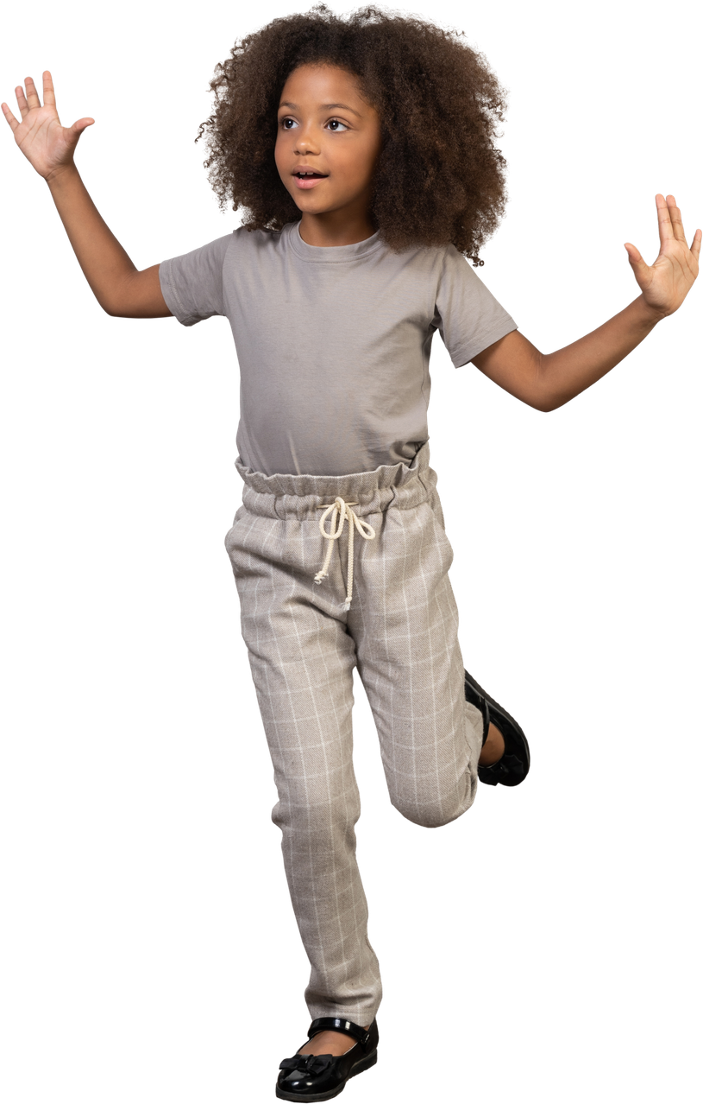
EVERY CHILD CAN UNDERSTAND AND RESPOND TO THE GOSPEL
WHEN WE GUIDE THEM WITH CARE & ASK THE RIGHT QUESTIONS
Notes:
Every child can understand and respond to the gospel.
There is no junior Holy Spirit. God is saving kids just like He saves adults.
How do we align our goals to join in the work that God is doing?
Our first goal is to present the gospel clearly.
Our second goal is guide kids with care. Asking questions is a big part of that.
-------testimony----------

Slide 8

WHAT EVANGELISM FOR KIDS IS NOT
  NOT PRESSURE
  NOT MANIPULATION
  NOT RUSHING DECISIONS
  NOT ADULT SIZED THEOLOGY

Slide 9
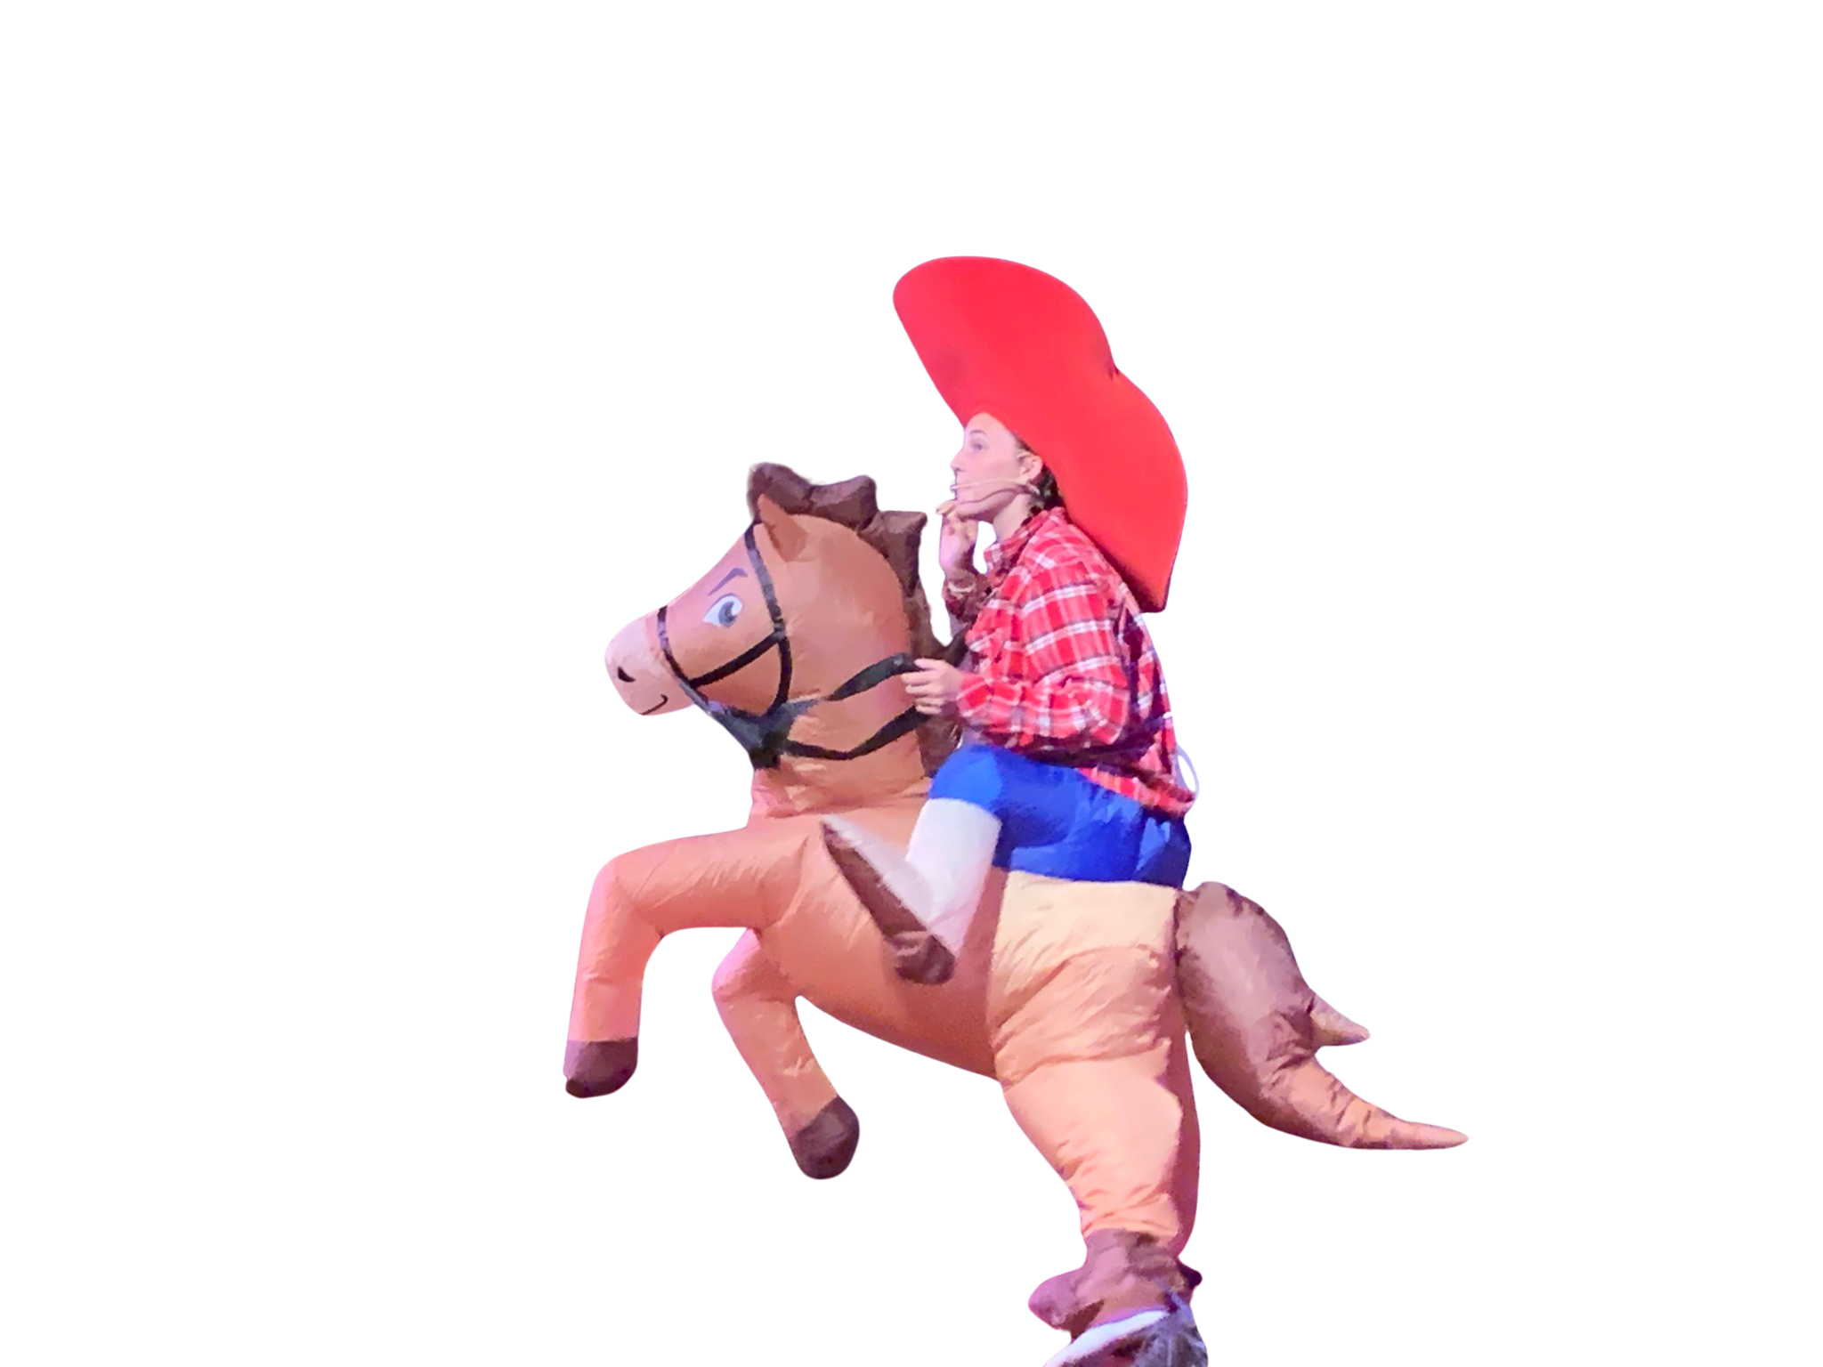
WHAT EVANGELISM FOR KIDS IS
  ATTENTION GRABBING
  CLEAR GOSPEL COMMUNICATION
  PATIENT GUIDANCE
  LISTENING BEFORE LEADING
  TRUSTING THE HOLY SPIRIT
Notes:
* Clear Gospel Communication:
We make sure to explain in a way that a child can understand.
* Patient Guidace:
We are willing to share the gospel over and over again; reexplaining concepts as needed. Always welcoming questions from kids - even the ones that are asked 100 times.
* Listening Before Leading:
Before we help a child respond to the gospel, we ask questions that help us guage understanding.
Trusting the Holy Spirit:
There is no junior Holy Spirit. God is saving kids the same way He saves adults. We can trust that his Word is powerful and we can share it and trust Him to do the work.

Slide 10
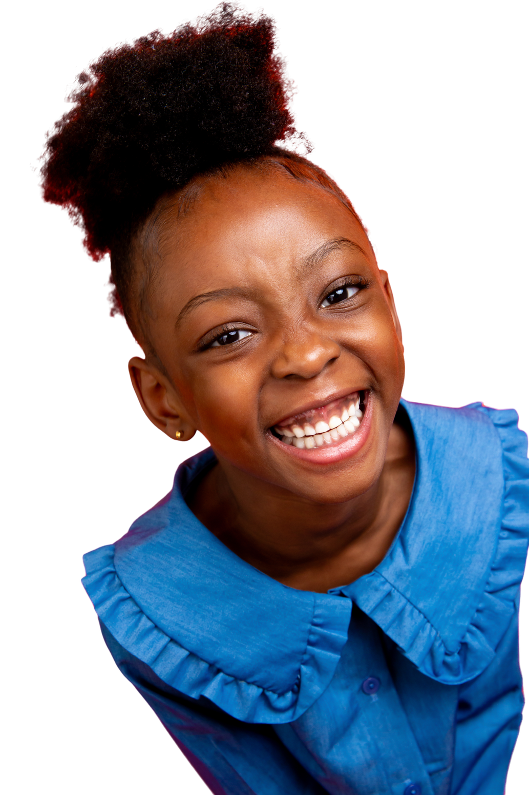
ISAIAH 55:8-11
WE MUST TRUST THE POWER OF GOD’S WORD OVER TIME.
FOR KIDS:
  HEARING TRUTH REPEATEDLY MATTERS
  PROCESSING MAY TAKE TIME
  FAITH TENDS TO GROW GRADUALLY
Notes:
Big picture of Isaiah 55
Isaiah 55 is an invitation.
God is speaking to people who are:
Spiritually hungry
Tired of chasing things that don’t satisfy
In need of grace, not performance
He invites them to come, listen, and receive—not to prove themselves.
What comes right before verse 11
Just a few verses earlier, God says:
“For my thoughts are not your thoughts,
and your ways are not my ways.” (Isaiah 55:8, CSB)
In other words:
God works differently than we expect.
His timing, methods, and outcomes are His.
Then God uses a very concrete picture (perfect for kids, honestly):
Rain and snow fall, water the earth, and make things grow. (Isaiah 55:10)
The growth doesn’t happen instantly.
But it does happen.
Then comes Isaiah 55:11
So when God says His Word “will not return empty,” He means:
His Word always does what He sends it to do
Even when people are still processing
Even when results aren’t immediate
Even when we can’t see the growth yet
The responsibility is faithful sowing, not forced results.
Why this matters for sharing the gospel with kids
This verse is not about instant decisions.
It’s about trusting the power of God’s Word over time.
For kids:
Hearing truth repeatedly matters
Processing takes time
Faith grows gradually
We don’t rush the rain.
We trust the growth.
Isaiah 55:8-11 reminds us that God’s Word works over time. Our job is to share it clearly and lovingly—and trust God with what it produces.

Slide 11

HOW
KIDS
UNDERSTAND
  CONCRETE THINKERS
  REPEAT WHAT THEY HEAR
  MAY MIMIC FAITH LANGUAGE
  NEED SPACE TO PROCESS TRUTH
Notes:
Concrete Thinkers
Why we share the gospel differently with kids
Kids are concrete thinkers. That means they don’t naturally understand abstract ideas like sin, salvation, grace, or faith unless those ideas are tied to something they can see, touch, hear, or imagine clearly.
Adults can understand:
“Jesus saves us from sin.”
Kids need:
“Sin is when we choose our way instead of God’s way—like lying, being mean, or disobeying. Sin separates us from God. Jesus came to fix that.”
Repeat What They Hear:
Why kids repeat what they hear
Because kids are concrete thinkers, they often repeat words before they understand meaning.
Repetition does not automatically equal belief.
A child can say:
“Jesus died for my sins”
and still be working to understand:
What sin actually is
Why Jesus had to die
What it means to trust or follow Him
They’re echoing language they’ve heard modeled—not being deceptive, not being shallow, just developing.
May Mimic Faith Language - this is similar to repeating what they hear, but its important to note that they may use "christianese" really well before they understand it.
Kids may mimic faith language
Because kids are concrete thinkers and strong imitators, they may mimic faith language before they understand faith.
They repeat what they hear from:
Parents
Teachers
Peers
Church culture
This is normal development—not manipulation or insincerity.
A child might say:
“Jesus lives in my heart”
or
“I asked Jesus to forgive me”
…but still be forming an understanding of:
Sin
Jesus’ death and resurrection
What it means to trust and follow Him
Why this matters when sharing the gospel
If we confuse mimicked language with personal faith, we risk:
Pushing kids past understanding
Treating words as the goal
Missing teachable moments
Instead, mimicking tells us:
This child is listening. This child is learning. This child is processing.
That’s a starting point, not the finish line.
How we respond as gospel-sharers
When kids mimic faith language, we:
Affirm their interest: “I’m glad you’re thinking about Jesus.”
Clarify gently: “What do you think that means?”
Explain concretely, again and again
We trade pressure for patience.
A clean line you can use in training
Because children are concrete thinkers, they may mimic faith language before they understand faith. Our role is to guide them toward understanding—not rush them into repeating the right words.
Need Space to Process Truth:
Because kids are concrete thinkers, they need time and space to process gospel truth before they can truly respond to it.
Processing for kids often looks like:
Repeating what they hear
Asking the same questions again and again
Trying out faith language
Connecting truth to real-life situations
That is learning.
Why space matters
The gospel isn’t a script to memorize—it’s truth to understand.
When kids are rushed:
Words may come before belief
Prayers may come before understanding
Confusion can come later
When kids are given space:
Understanding deepens
Questions surface
Faith becomes personal
What giving space looks like
Giving kids space doesn’t mean avoiding the gospel.
It means walking with them through it.
We:
Share the gospel clearly and often
Invite, but don’t pressure
Answer questions honestly
Celebrate curiosity as growth
We trust the Holy Spirit to work over time. Children need space to process gospel truth. Repetition, questions, and even mimicking faith language are signs that God is at work—not signs that we should rush them to a decision.
The big picture
We plant.
We water.
God gives the growth.
(1 Corinthians 3:6)

Slide 12
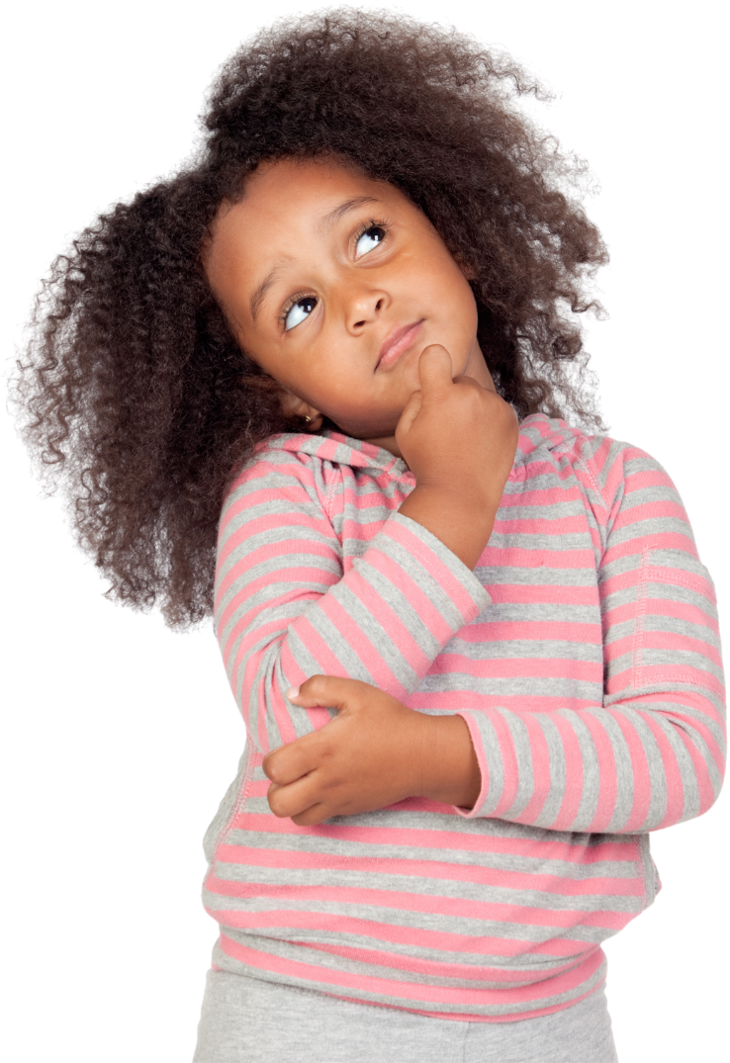
ASK
  WHY DID YOU WANT TO TALK WITH ME?
  WHAT DO YOU THINK SIN IS?
  ARE YOU A SINNER?
  WHY DO YOU THINK JESUS DIED?
  WHAT DOES IT MEAN TO FOLLOW JESUS?
UNDERSTANDING COMES BEFORE RESPONSE
Notes:
Ideas for questions to ask

Slide 13
SHARING
THE
GOSPEL
CLEARLY
Notes:
We need to find ways to share the gospel with all types of learners:
Visual: processes ino by charts and graphs, needs images to process concepts and ideas, prefer graphic elements over words,
Auditory: learn best when info is spoken, prefer lectures and discussions, processes information by talking through things
Read/Write: Prefer to receive written word, enjoy reading and writing assignments, processes info by writing notes
Kinesthetic: learn best through tactile processes, processes information by recreating and practicing

Slide 14


GREAT FOR SUNDAYS & VBS
THE GOSPEL:
GOD’S PLAN FOR ME
Notes:
How do we make it
Visual : charts with symbols
Auditory: we say it or sing it
Kinesthetic: puzzles, motions
Read/Write: fill in the blank worksheets, decoder games

Slide 15
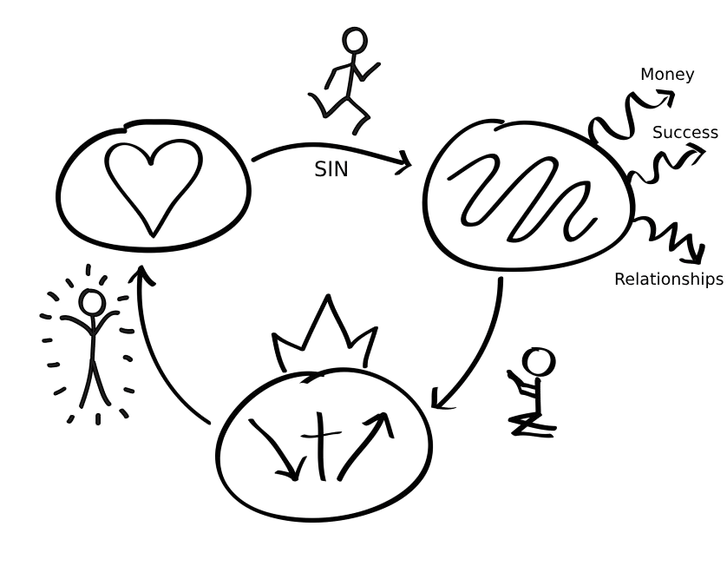

PERFECT FOR SUNDAYS, OUTREACH EVENTS, VBS, & DISCIPLESHIP
3 CIRCLES
KIDS CAN LEARN THIS METHOD TOO
Notes:
How do we make it
Visual : charts with symbols
Auditory: we say it or sing it
Kinesthetic: have kids practice writing it, let them use play doh,
Read/Write: have them practice with a partner and give them cue cards

Slide 16
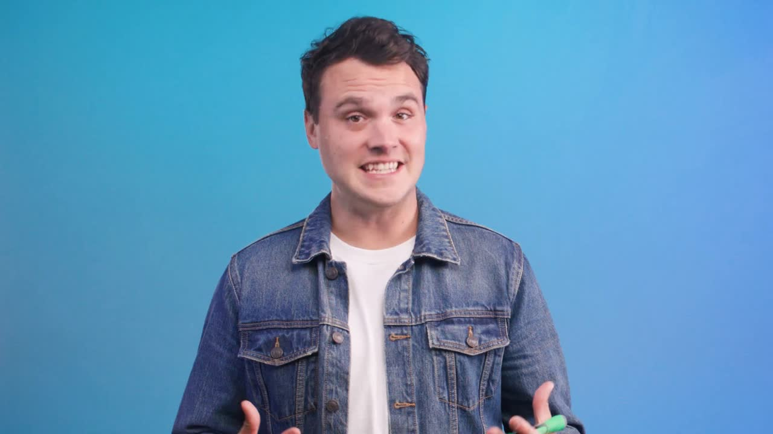

Slide 17
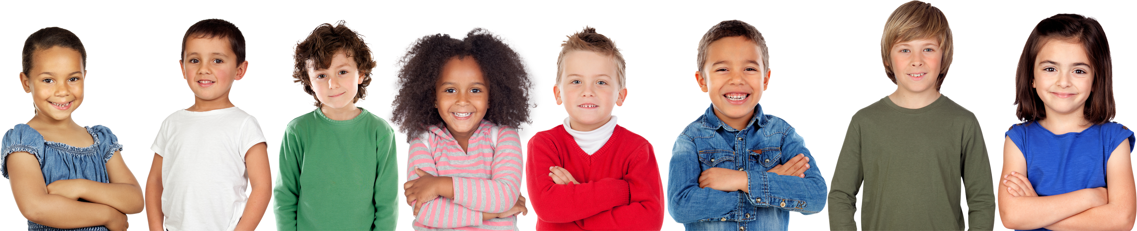
OUR RESPONSIBILITY TO KIDS DOES’NT END AT A DECISION
Notes:
Because kids are often on a road to faith, we continue to share the gospel with them.
We trust that God can save them.
We also understand that they are learning and growing.
We continue to teach the gospel while we disciple our youngest learners.

Slide 18

KIDS CAN LEARN TO SHARE THEIR FAITH TOO
  TELL WHAT JESUS DID
  SHARE THEIR STORY
  INVITE OTHERS
Notes:
Kids can learn more about the gospel by sharing it with others - even before they have fully accepted it.
We must remember that there is no junior Holy Spirit. God is calling kids to Himself.
Kids can share their story with their friends and family.

Slide 19
WE DON’T JUST REACH KIDS.
WE EQUIP KIDS TO REACH OTHERS.
DISCIPLES MAKE DISCIPLES
Notes:
Disciples make disciples - no matter their age.
Plus, by teaching how to share the gospel - we end up repeating the gospel and asking kids to repeat it to us and others.

Slide 20
IF WE BELIEVE THAT GOD CAN SAVE KIDS
THEN WE HAVE TO BELIEVE THAT GOD CAN
USE KIDS TOO.
Notes:
If we believe that God can save kids - then we have to believe that God can use kids too.
We should equip them and encourage them to follow Jesus in all ways - including sharing their faith.
Kids can tell their story.
Kids can share the gospel.
Kids can make disciples.
Discipleship is so important.

Slide 21
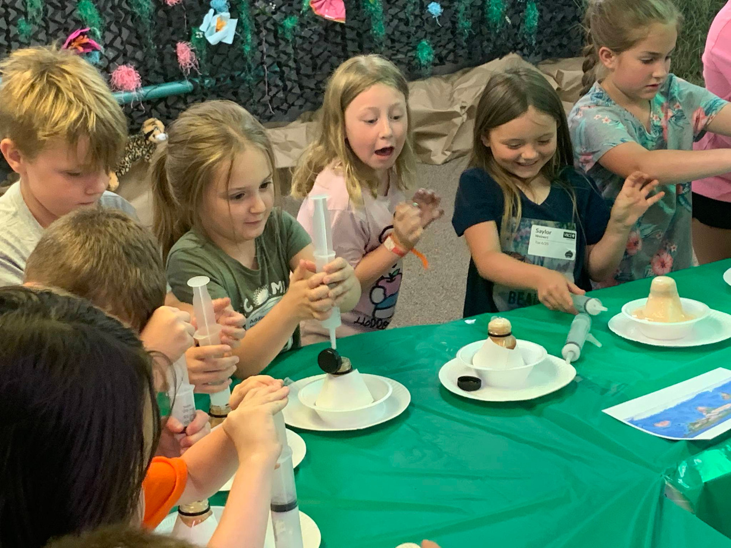
AS KIDS UNDERSTAND AND RESPOND TO THE GOSPEL, WE MUST NOT NEGLECT
TEACHING THEM TO DEFEND THEIR FAITH.
Notes:
Why do kids who understand and respond to the gospel walk away from the church after they graduate high school?
It's one of two reasons.
#1. They didn't truly become a follower of Jesus.
#2. They didn't learn to defend their faith.
Who will they need to defend their faith against?
The enemy will lie to them. They need to be able to lead their hearts and minds back to the truth in God's Word.
They will need to give an answer for their faith when other faith's try to prove it wrong.
Thought provoking: How many of you use science in your ministry to children?
Science is real. Science can be proven. Science is concrete. So when someone says that something isn't true - they know what is true because they have seen the evidence.

Slide 22
GOING
BOLD
IN YOUR MINISTRY
Notes:
How can i help?
Trainings:
Leading Kids to Christ
What your ministry needs to know about Generation Alpha if you want to reach them.
Types of Learning
BeAttitudes: Be Safe, Be Engaging, Be Courteous, Be Consistent
Partnering with Parents to Make Disciples
Abuse Prevention
VBS Director Coaching
VBS Training for your team
KidMin Leader Coaching

Slide 23
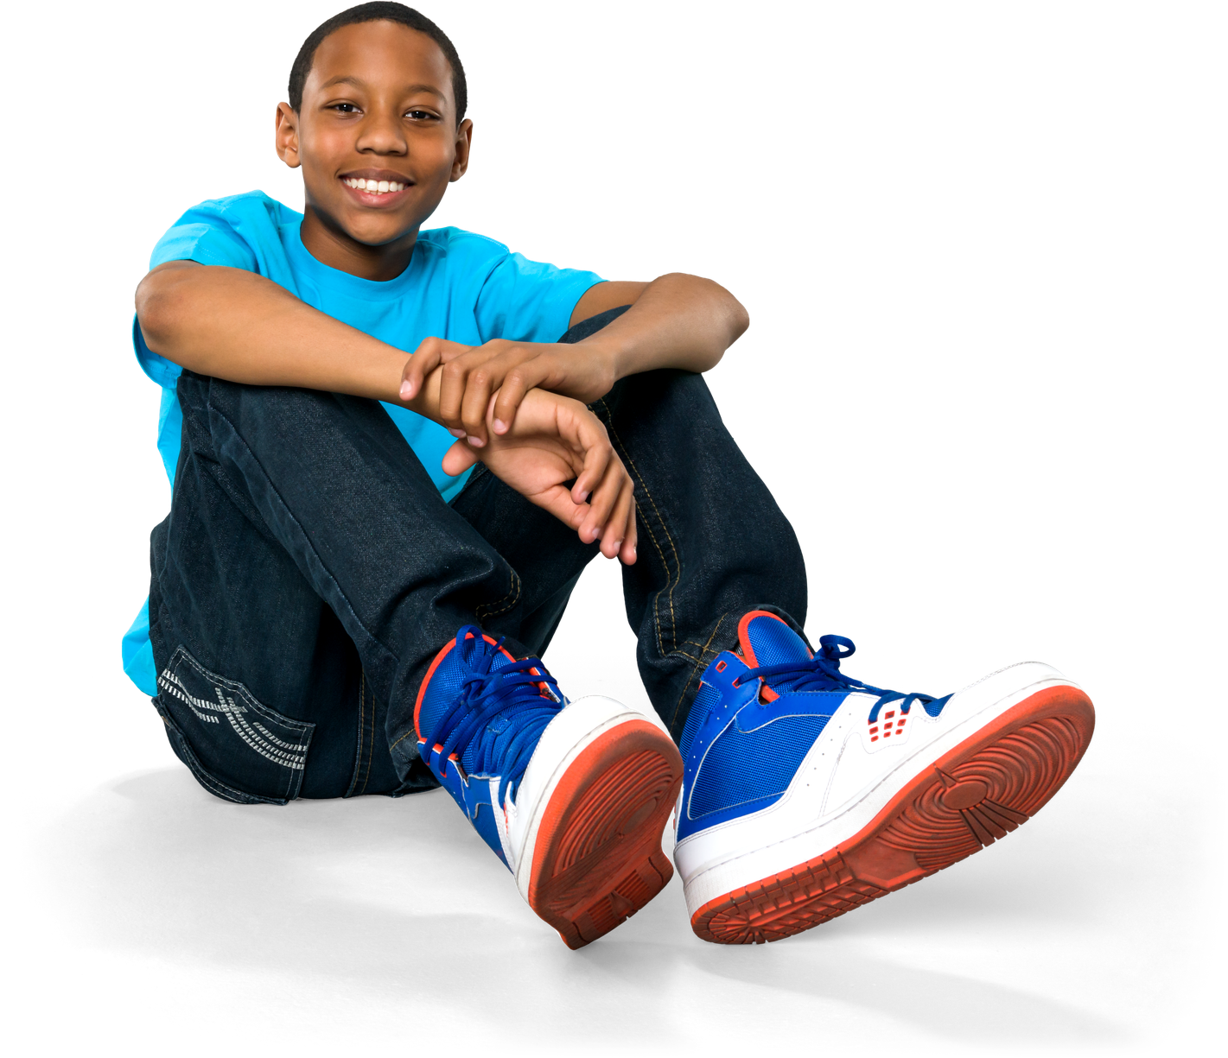
JESUS INVITES CHILDREN TO COME TO HIM
SO SHOULD WE.
EVANGELISM TO KIDS MATTERS.
Notes:
Jesus invites children to come to Him - so should we.
We must make evangelism part of our strategy in our kids ministries & outreach.

Slide 24

JESUS INVITES CHILDREN TO KNOW HIM
SO SHOULD WE.
DISCIPLESHIP MATTERS.

Slide 25

JESUS INVITES CHILDREN TO MAKE DISCIPLES
SO SHOULD WE.
DISCIPLED KIDS CAN SHARE THE GOSPEL & DEFEND THEIR FAITH.
Notes:
Our goal is not to get a kid to say a prayer. Its to see a kid become a disciple.
Bold evangelism plants the truth; God brings the growth in a child’s life.

Slide 26


Slide 27
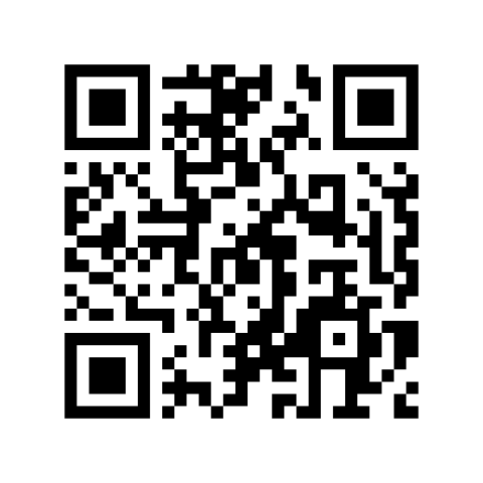
KEEP IN TOUCH
MY CONTACT INFO
HOW CAN I SUPPORT YOUR MINISTRY?
BRNUNITED.ORG
Notes:
Training
Coaching
Prayer Support
May our evangelism to kids be bold, clear, and creative—and may our efforts show our trust in God to do the saving and the growing.

