Slide 1

Evangelism101
Advance Conference 2026
Dr. Larry L. Anderson, Jr.
Director of Church Advancement and Evangelism

Slide 2


Evangelism 101
Developing a Heart for the Lost
When he saw the crowds, he had compassion on them, because they were harassed and helpless, like sheep without a shepherd. Then he said to his disciples, “The harvest is plentiful but the workers are few. Ask the Lord of the harvest, therefore, to send out workers into his harvest field.” Matthew 9:36,37

Slide 3


Session Goal
Understand the heart behind evangelism and recognize everyday opportunities to share the Gospel.
Understand sharing the Gospel is about conversation (what we can
do) and conversion (what we cannot do).
We can plant, we can water but God gives the increase.
1 Cor. 3:6,7

Slide 4


The Great Commission
Then Jesus came to them and said, “All authority in heaven and on earth has been given to me. Therefore go and make disciples of all nations, baptizing them in the name of the Father and of the Son and of the Holy Spirit, and teaching them to obey everything I have commanded you. And surely I am with you always, to the very end of the age.”
(Matthew 28:18-20 )

Slide 5


The Gospel Message
1 Corinthians 15:3–4, “For what I received I passed on to you as of first importance that Christ died for our sins according to the Scriptures, that he was buried, that he was raised on the third day according to the Scriptures…”
  Christ died for our sins
  He was buried
  He rose again

Slide 6

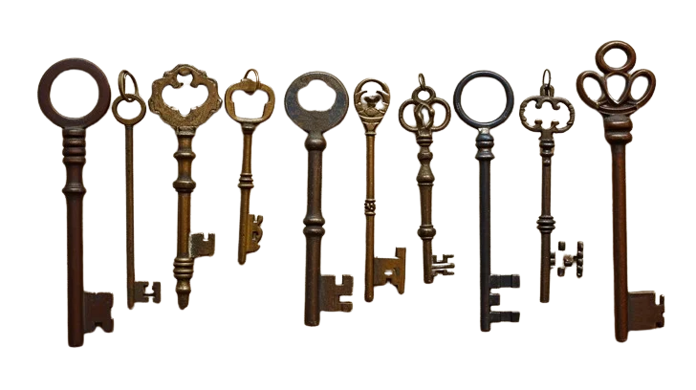
ABC
The
Romans
Road
G.O.S.P.E.L.
Key Truth
Evangelism is not centered on method — it is centered on motive.
Four
Spiritual
Laws
3 Circles
So we have the message, the method and the marching orders, but many lack the motive.

Slide 7
So We Are Commanded to
Love God
and
Love People
Jesus said - Love the Lord your God with all your heart and with all your soul and with all your mind.’ This is the first and greatest commandment. And the second is like it: ‘Love your neighbor as yourself.’ Matthew 22:37–39
The Greatest Commandments

Slide 8

Love for God
How do we love God?
“If you love Me,
keep My commandments.”
John 14:15

Slide 9

God's Heart
God desires that none should perish but that all come to repentance.
“The Lord is not slow in keeping his promise, as some understand slowness. Instead he is patient with you, not wanting anyone to perish, but everyone to come to repentance.”
(2 Peter 3:9)

Slide 10

Love for People
Loving people and honoring God, means caring about their eternal destiny.

Slide 11
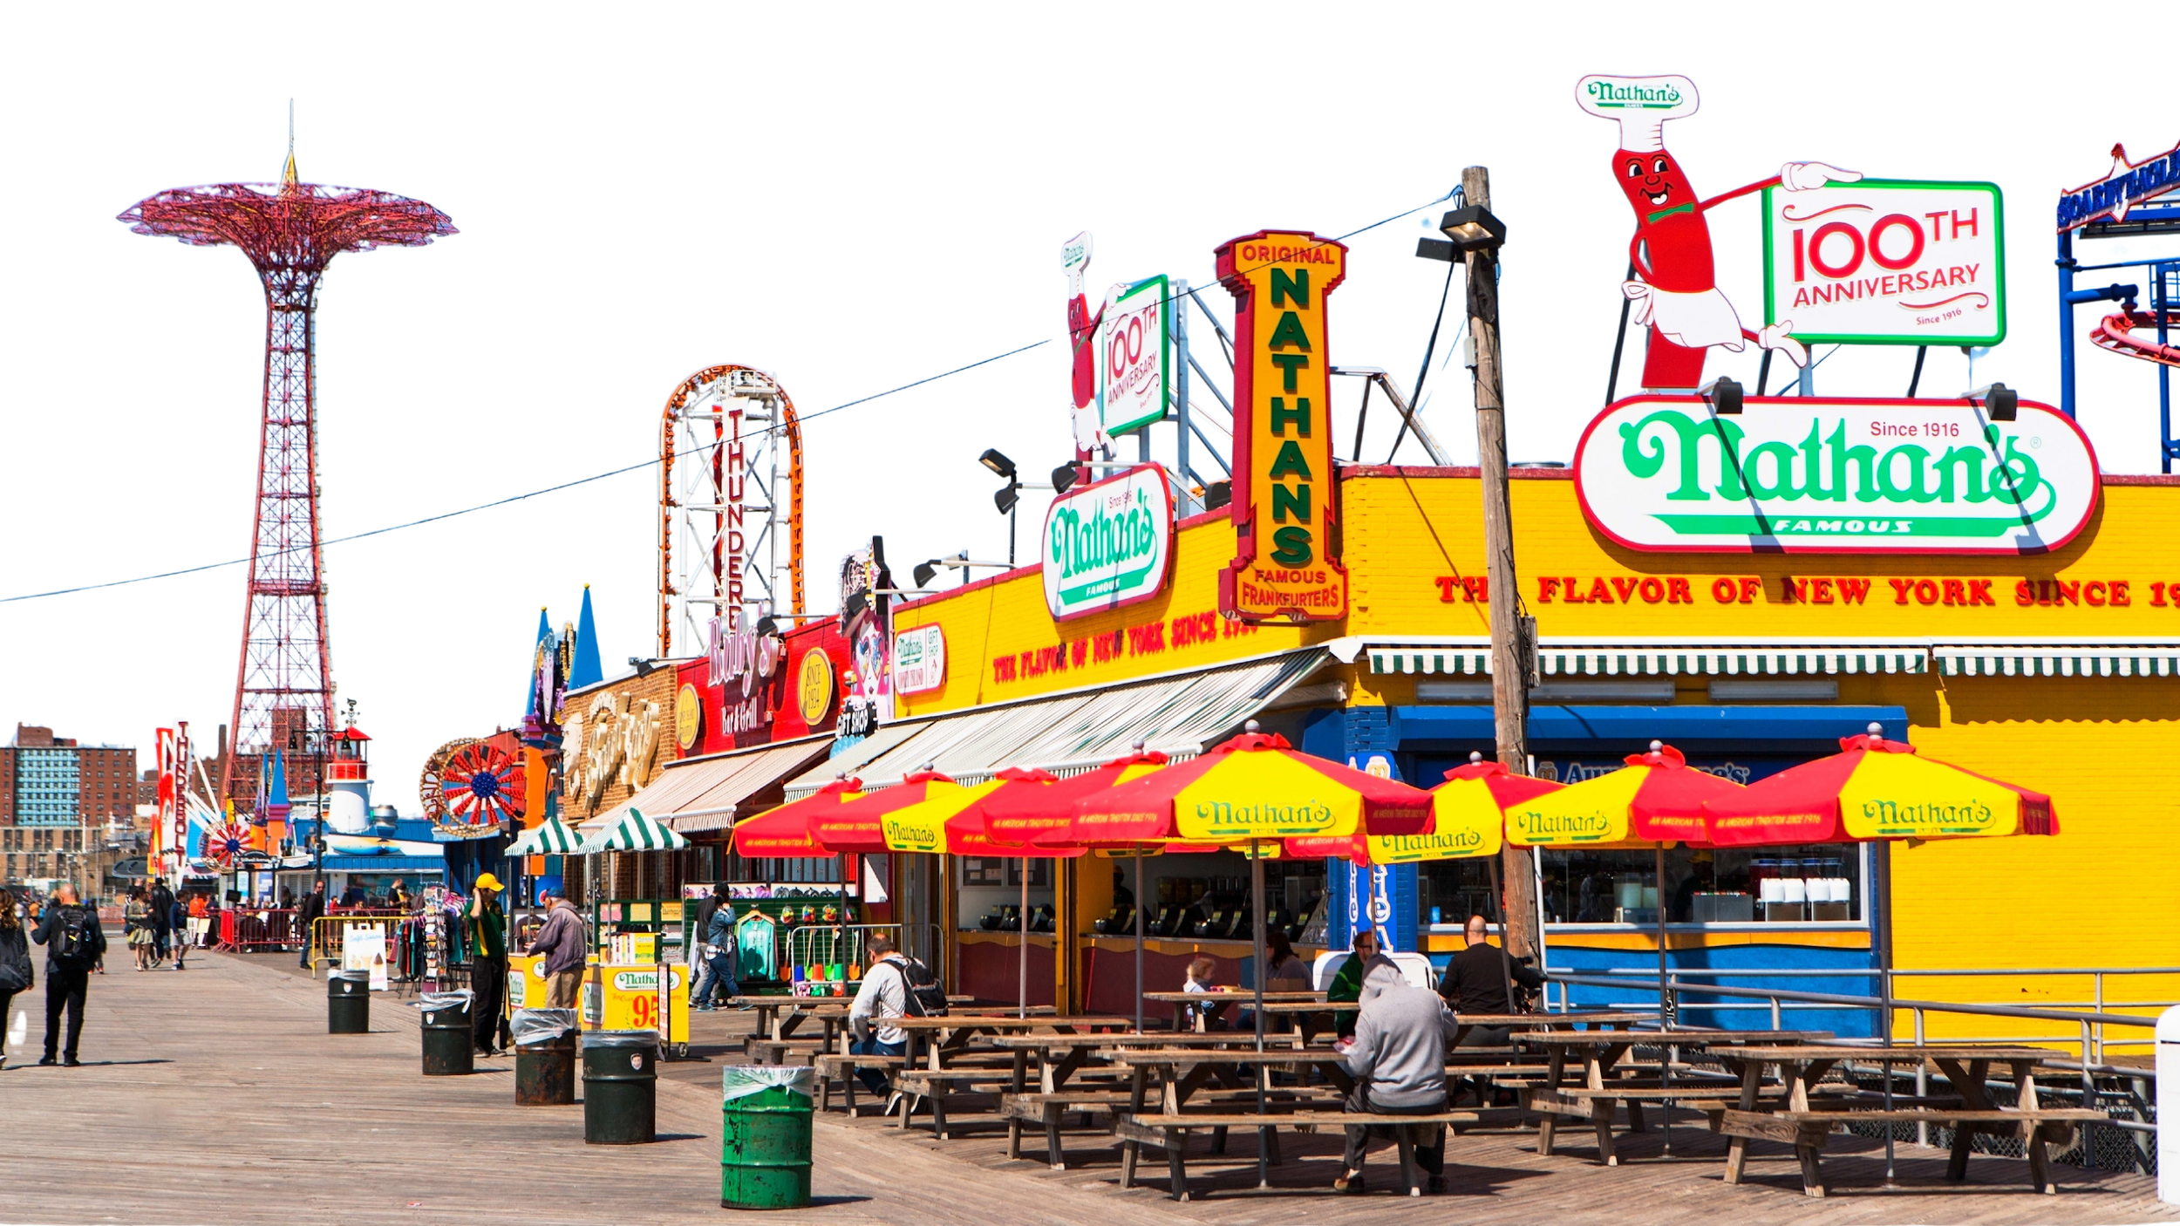
Coney Island

Slide 12

We Must Intentionally Seek:
  Personal Evangelism Opportunities
  Digital Evangelism Opportunities
  Communal Evangelism Opportunities
  The only thing worse than being lost is being lost and no one is looking for you.
Key Statements

Slide 13
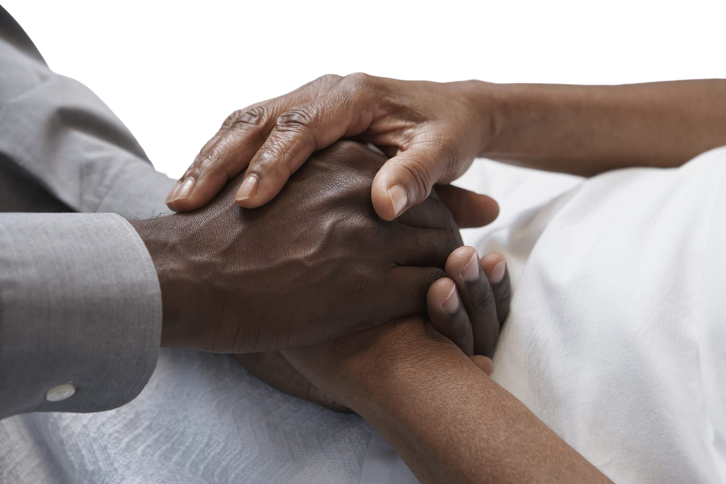
We Must Care Then Share
Attempt to build genuine
relationships before sharing the message.
Personal – you have some in person interaction.
Digital (Social Media)
you have a
predominate digital
centered relationship.
Communal – You share a regional
residential space.

Slide 14
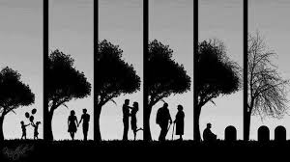
  Life Moments:
  Sickness
  Death
  Birthdays and New Births
  Weddings and Anniversaries
  Career changes and retirement
  Major milestones that warrant celebrations
Personal

Slide 15

Don’t just care about their Destiny, care about their Day.
Don’t limit your contact to only being your witnessing to them.
Don’t reflect what they reject, allow them to see the Spirit they neglect.

Slide 16

Be Intentional * Authentic * Relational
Share testimonies, how you came to faith and answered prayers.
Social Media Evangelism
Share encouraging Scriptures and what they mean, you are not preaching, you are experiencing God and allowing others to do it with you.
Notice "friends” life moments.
Send direct messages, prayers and
encouragement
Share Encouraging moments from church and how it made you feel. -Sermon quote, -Worship song, -Baptism picture and story. -Let people see your faith lived out in community
Make yourself available for prayer follow up.

Slide 17

The World Is Watching
“Many people may never walk into a church building, but they walk onto social media every single day. That means every believer already has a mission field in the palm of their hand.”
Your social media is not just a platform for information, it can become a platform for transformation.

Slide 18
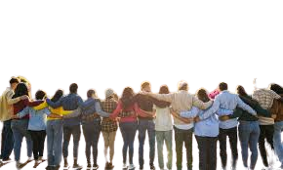
Communal
Self appoint yourself as Neighborhood Chaplain.
Adopt Nehemiah Spirit – Help Rebuild Walls
Be present in
your community,
Where do people
gather and why?
Respond to Life Moment’s and needs with compassion and prayer.

Slide 19

Closing Challenge
Ask God for:
  A heart for the lost
  Eyes for opportunities
  Courage to share the Gospel

