Slide 1
BOLD MOVE
Dr. Barry Whitworth

Slide 2


Slide 3
55
MORE THAN HALF A CENTURY OF:
Kingdom impact
church servicing & resourcing
Gospel advancement across PA/SJ
BAPTIST
RESOURCE NETWORK OF PA/SJ

Slide 4



Slide 5
“To whom much is given, much is required.”

Slide 6
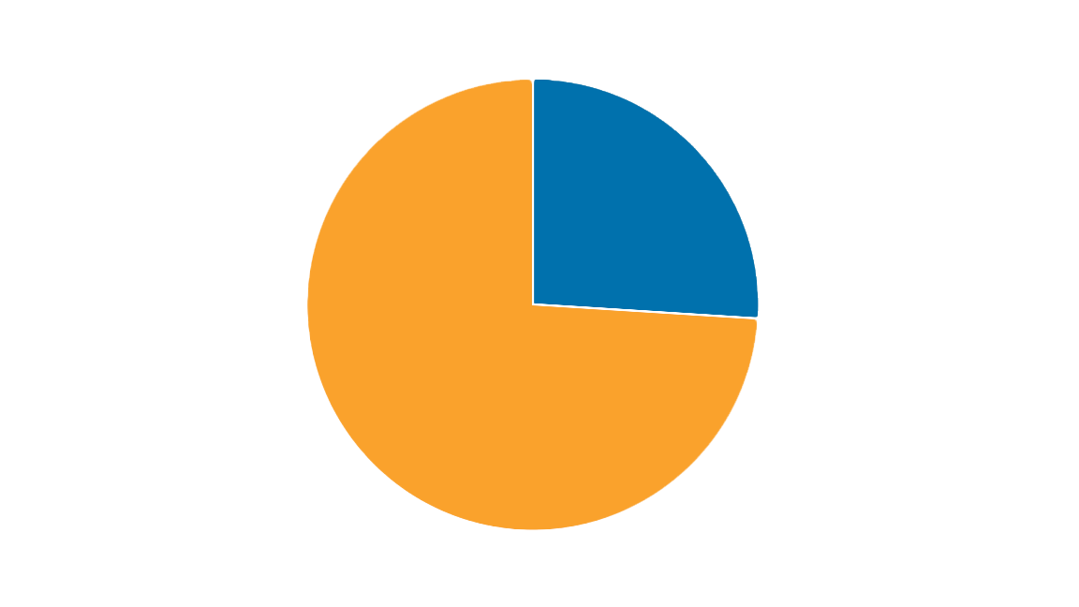
“To whom much is given, much is required.”

Slide 7
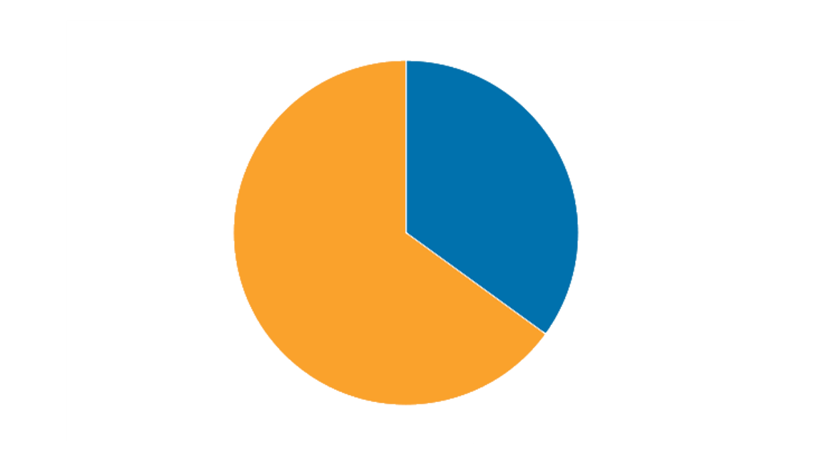
Today, we celebrate reaching 35%—a steady 1% increase each year over eight years!

Slide 8

CENTENNIAL COOPERATIVE PROGRAM
Challenge
Let's celebrate the Cooperative Program's 100 years of impact!
Consider adding an extra $100 to your monthly, quarterly, or one-time church gift to the Cooperative Program.

Slide 9

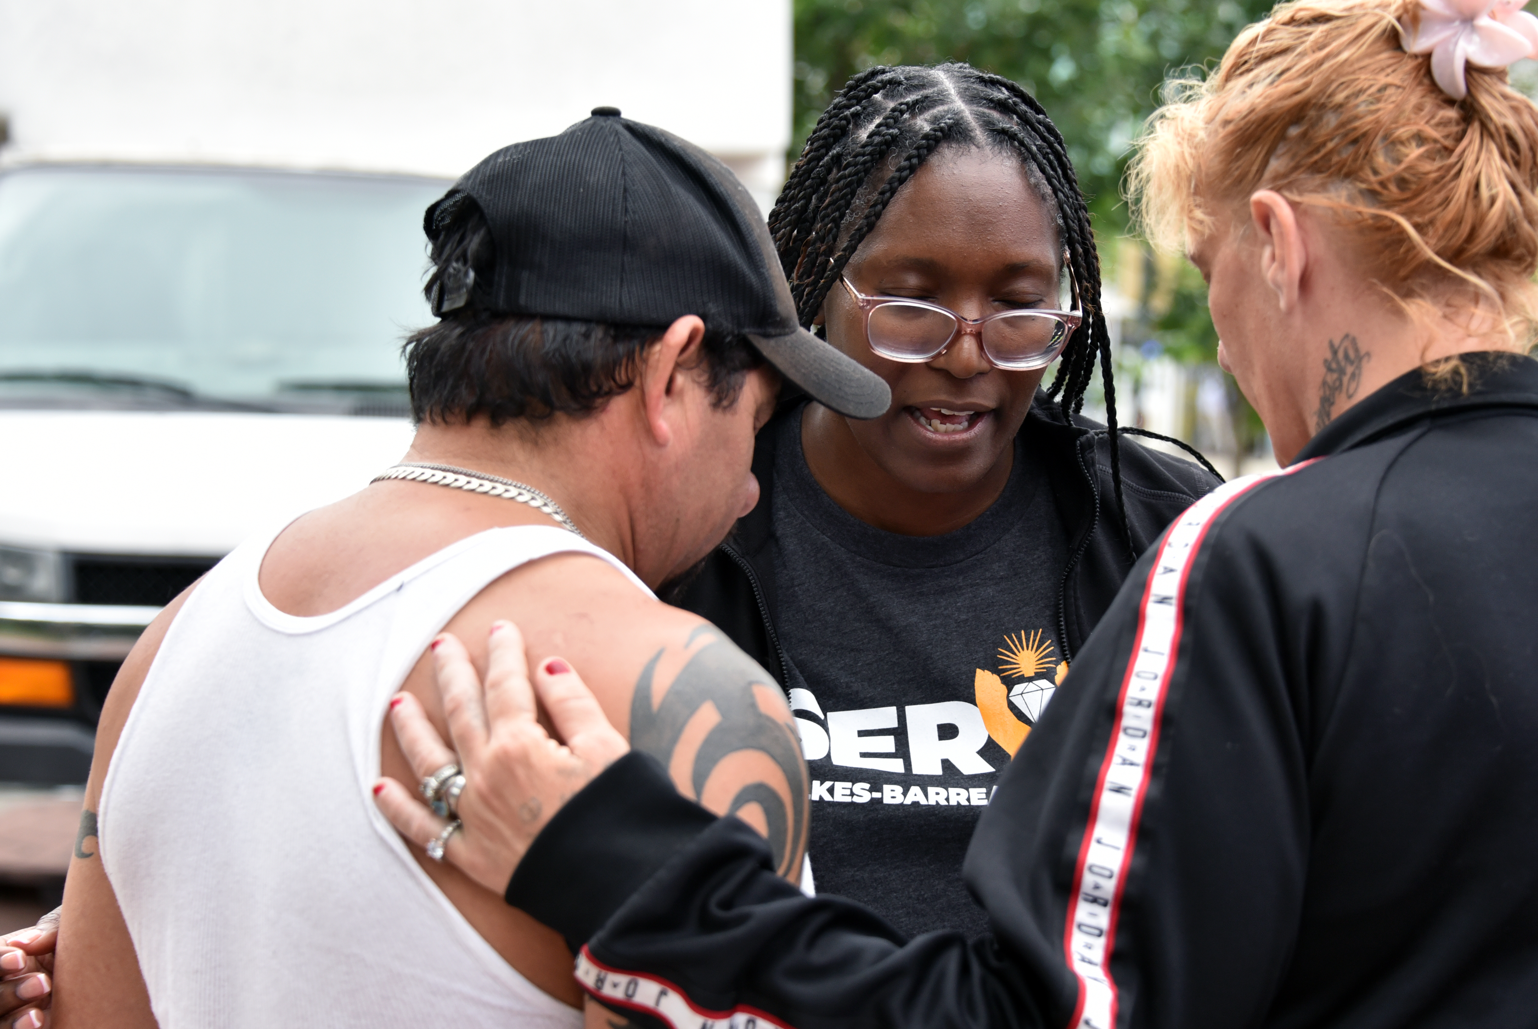
Completed 54 projects with 538 volunteers, nearly doubling Erie’s turnout and matching Philadelphia’s.
These volunteers gave over 10,000 hours of service, reached 8,500 people, and had 1,500 gospel conversations—resulting in 35 decisions for Christ.

Slide 10


Slide 11
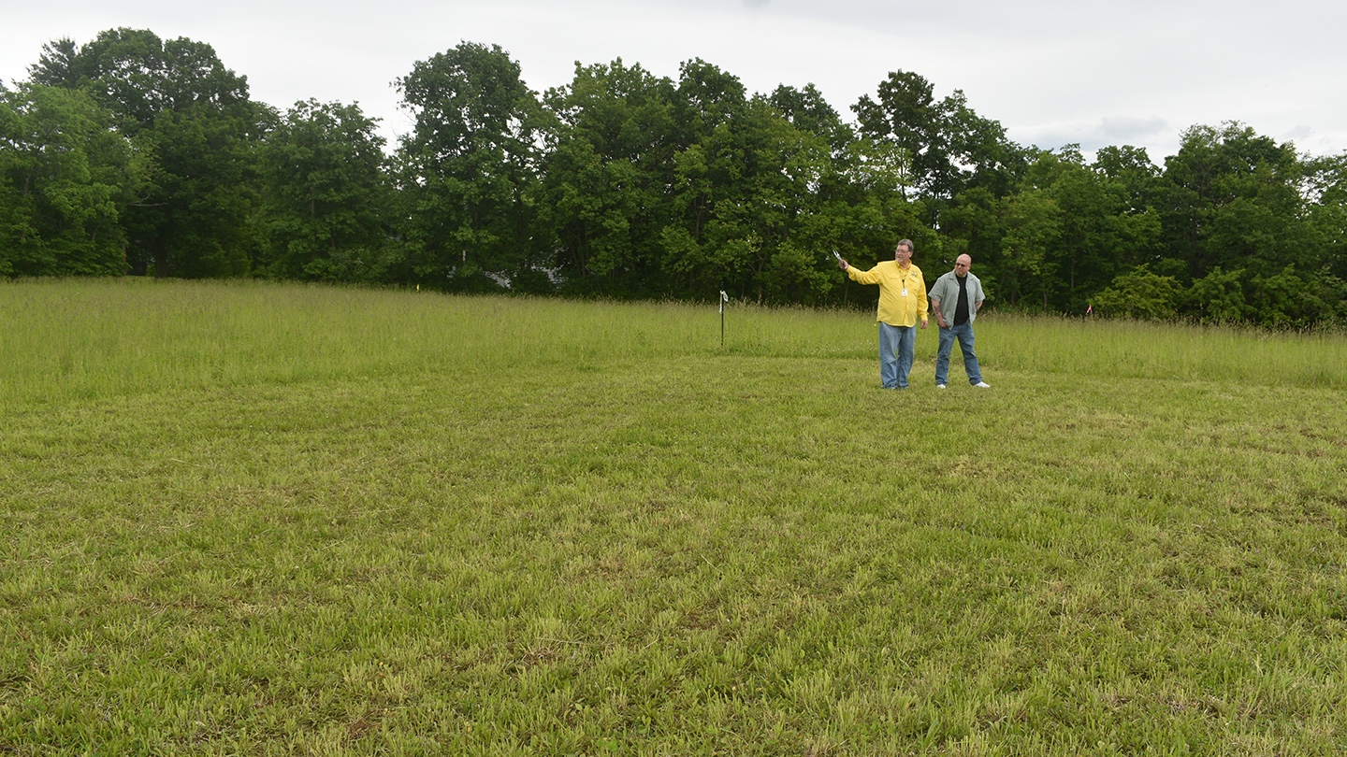

BRN RESPONSE AND RELIEF CENTER CAMPAIGN
Over $400k raised after May 30 fundraising banquet and other efforts

Slide 12


Slide 13
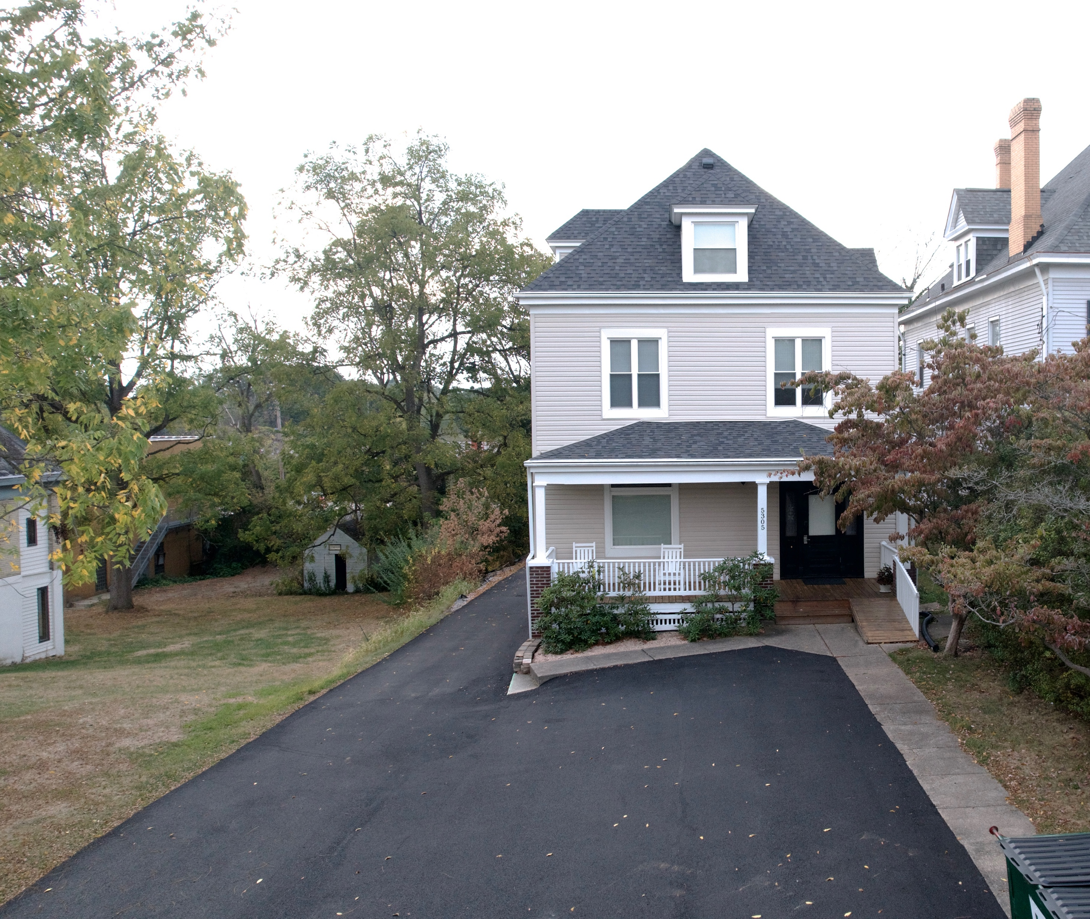
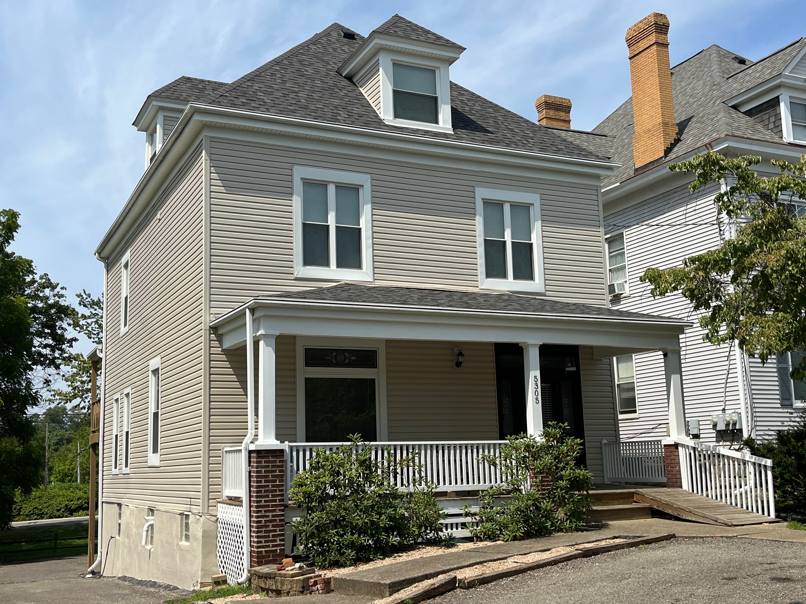
We’re so grateful for the
PITTSBURGH-
WARREN
MISSION HOUSE
renovations by Saluda Baptists

Slide 14

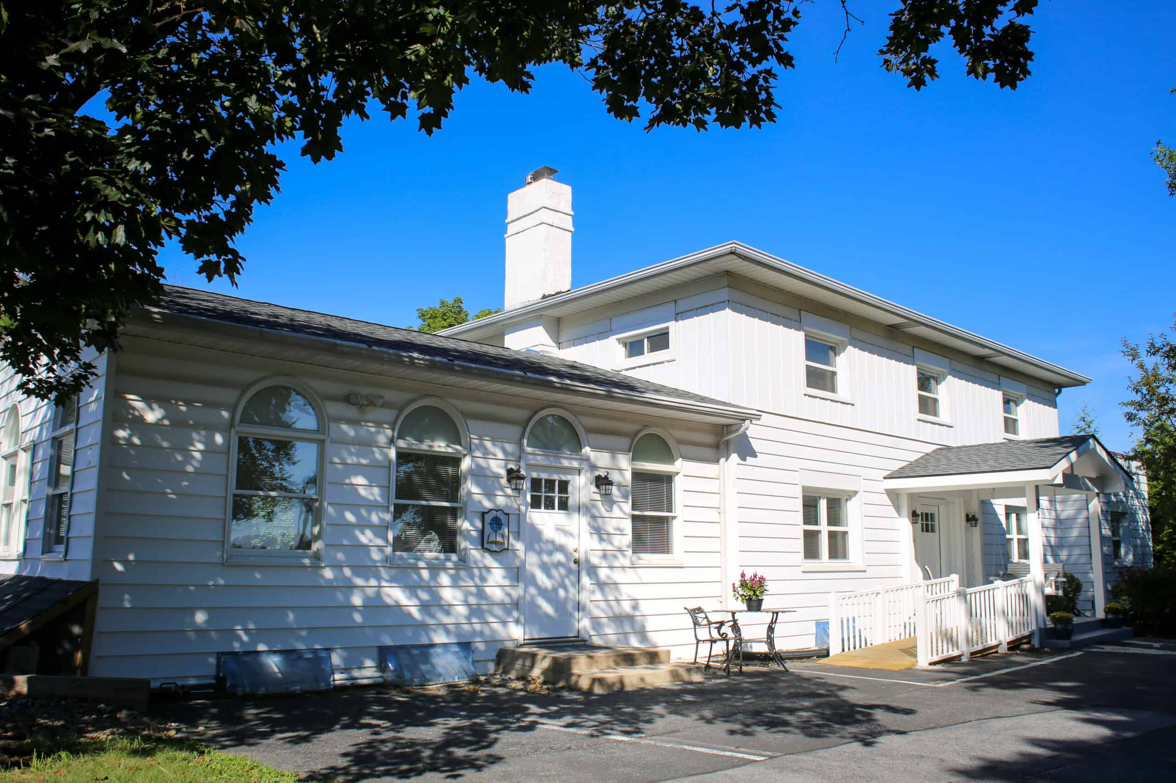
We’re so grateful for the
VOLUNTEER
MISSION HOUSE IN
HARRISBURG
renovations led by Dewey & Kathie Aiken

Slide 15
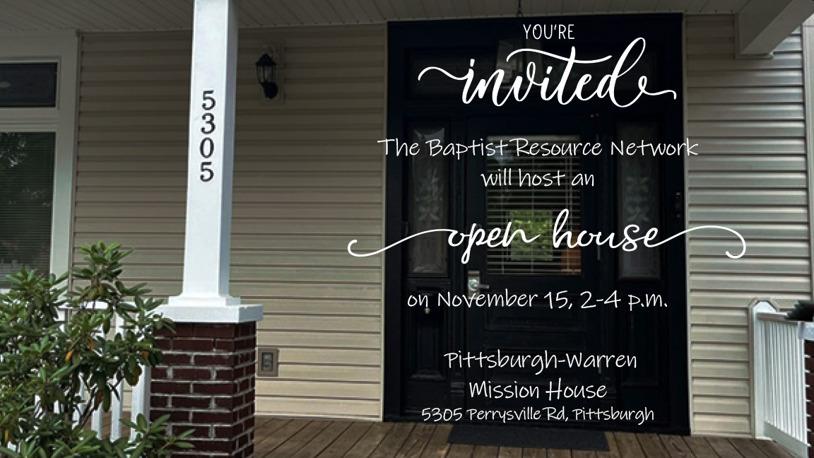

Slide 16
BRN Associate
Membership
Rollout

Slide 17
New BRN Non-Profit

Slide 18


NEXT LEVEL BLUEPRINT &
THE NEXT LEVEL JOURNEY

Slide 19
BOLD MOVE

Slide 20
JOSHUA 1:9
“Have I not commanded you? Be strong and courageous. Do not be afraid; do not be discouraged, for the Lord your God is with you wherever you go.”

Slide 21
JOSHUA 24:15
“Choose this day whom you will serve… but as for me and my house, we will serve the Lord.”

Slide 22
Bold spiritual movements are always birthed in prayer.

Slide 23
“Whenever God determines to do a
great work, He first sets His people to pray.”
CHARLES SPURGEON

Slide 24
Prayer is the launching pad for bold spiritual movement.

Slide 25
Bold moves are
not impulsive — they are prayerfully discerned and divinely directed.

Slide 26
When prayer leads, Scripture shows that boldness always follows.

Slide 27
Only the gospel can heal what hatred has broken.

Slide 28
WE MUST NOT
MISS THIS MOMENT.

Slide 29
No prayer,
no movement. No awakening.

Slide 30
The Church must awaken to the urgency of prayer.

Slide 31
When prayer is
minimized, even unintentionally, we limit our capacity to experience a
fresh move of God.

Slide 32
“But from this day on, the prayer meeting will be the barometer of our church.”
JIM CYMBALA

Slide 33
A call to return to the altar.

Slide 34
Malachi 3:7
“Return to me, and I will return to you,” says the Lord Almighty.”

Slide 35
The fire doesn’t fall where the altar is empty.

Slide 36
God moves when His people cry out.

Slide 37
Jeremiah 29:13
“You will seek me and find me when you search for me with all your heart.”

Slide 38
Make your next
bold move a commitment to
deeper, more
consistent prayer.

Slide 39
It’s time to return to the altar.

Slide 40
It’s time to
fall to our knees and get on our
faces.

Slide 41
It’s time to cry
out for revival—not just in our churches,
but also in our
own hearts.

Slide 42
Let’s pray. Boldly. Fervently. Together.

